Slide 1
Pipeline 1 (Azure Synapse Analytics)
ADLS(Synapse) > ADLS (ADF/Databricks) > Dedicated SQL (Synapse)

Slide 2
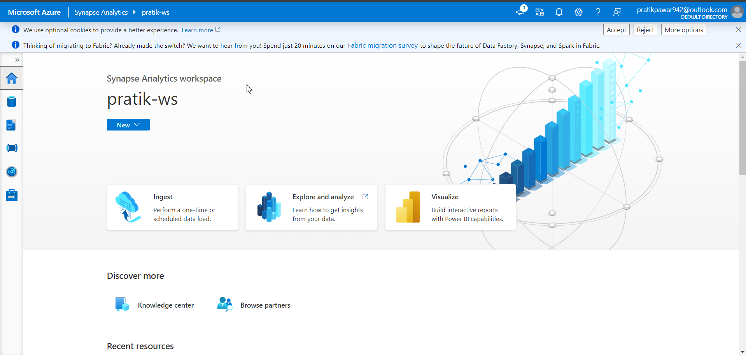
Azure Synapse Analytics WS

Slide 3
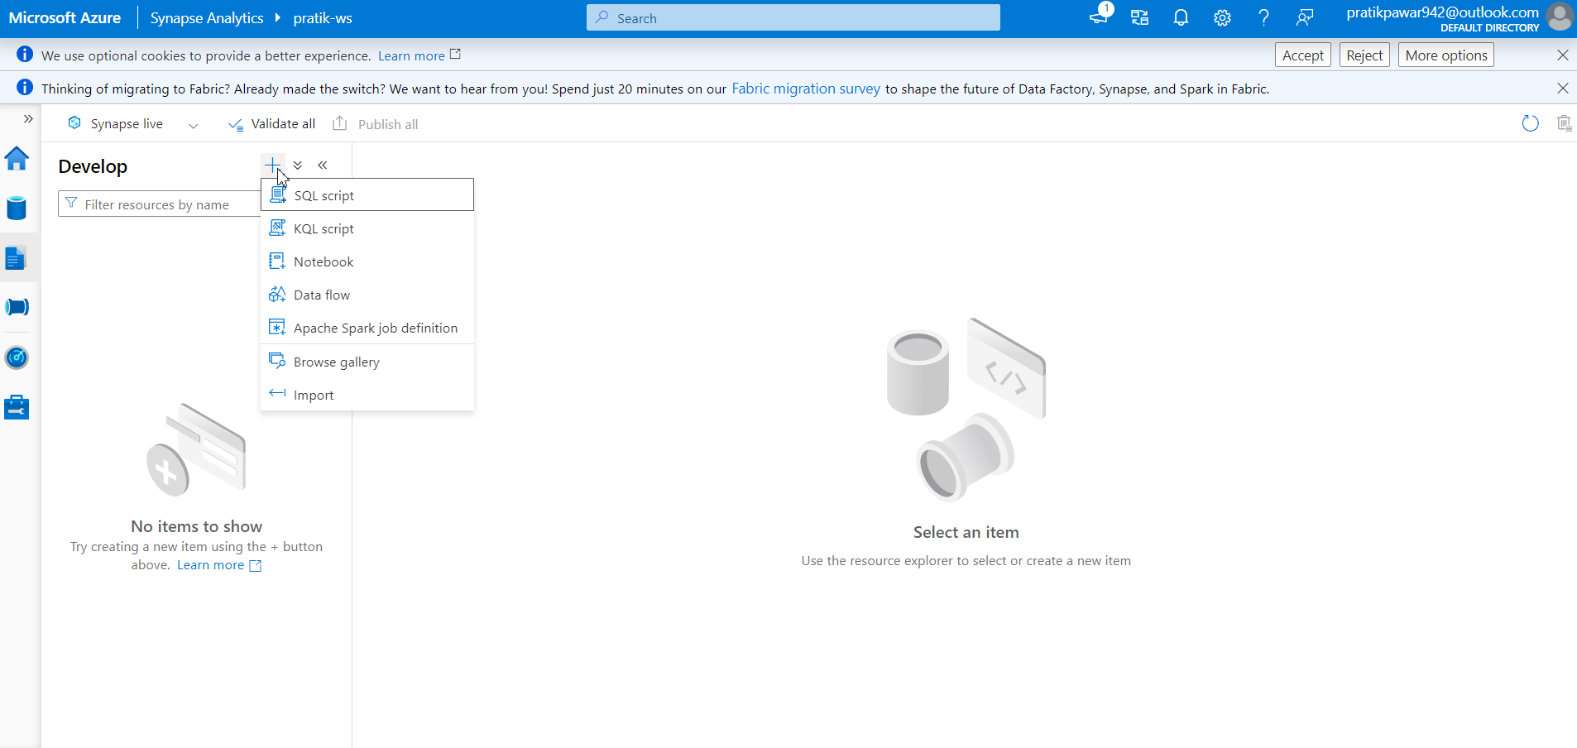
Go to Develop > click ‘+’ . This services we can perform in Synapse

Slide 4
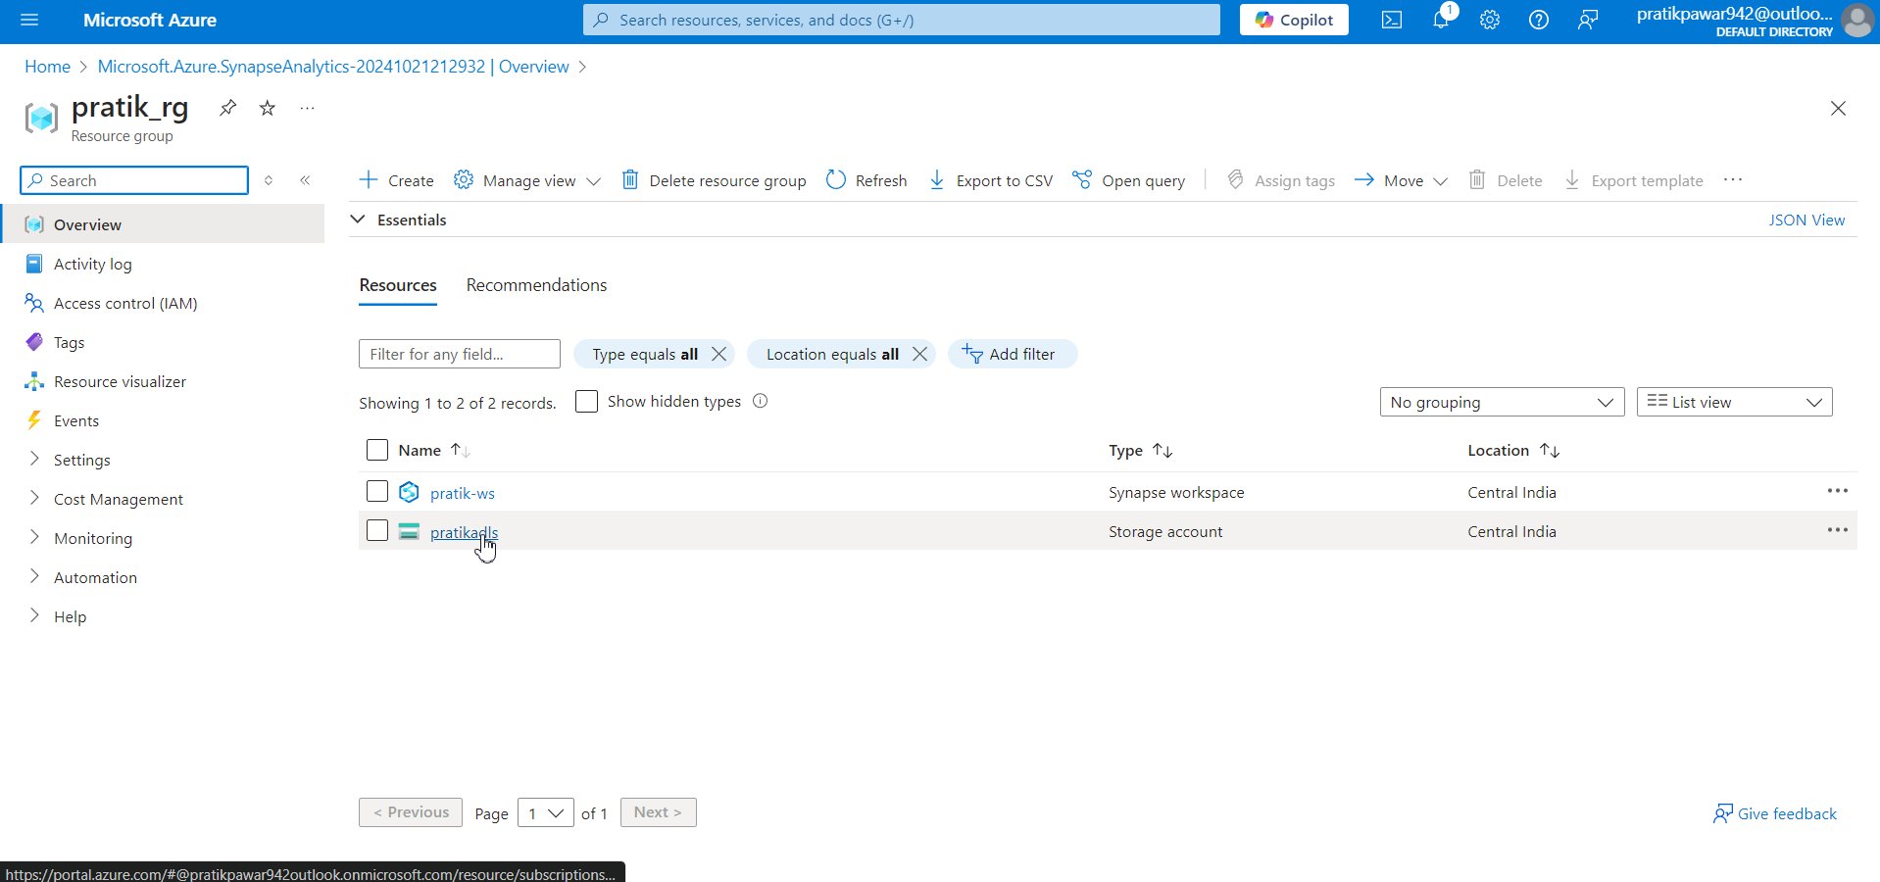
Now go to resource group, this is ADLS which is created during synapse creation. Its already linked to Synapse WS

Slide 5
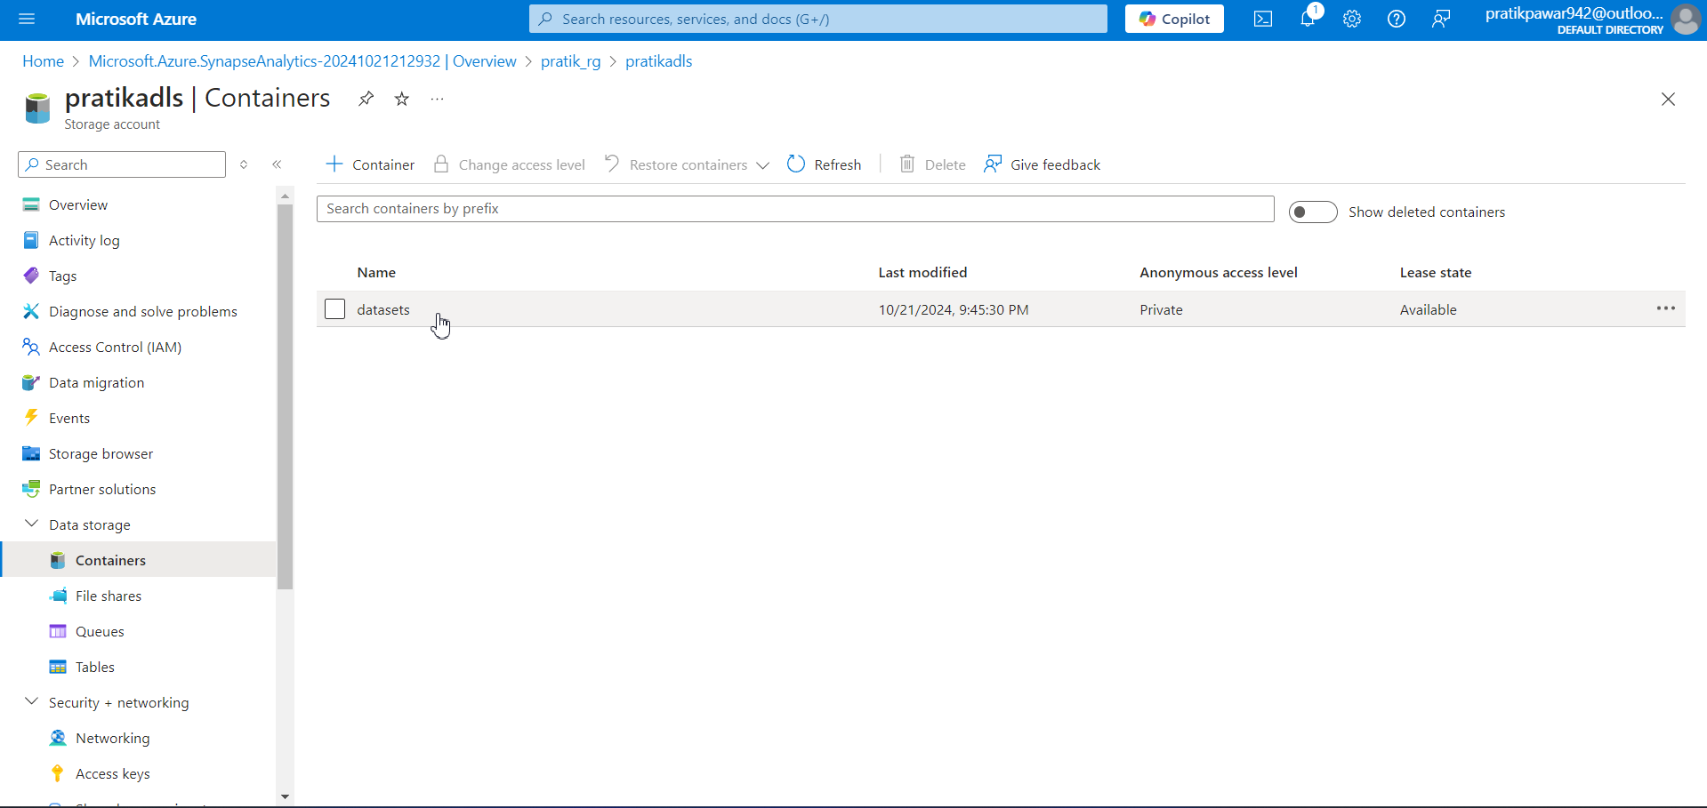
Now go to container > datasets ( Named this during creation)

Slide 6
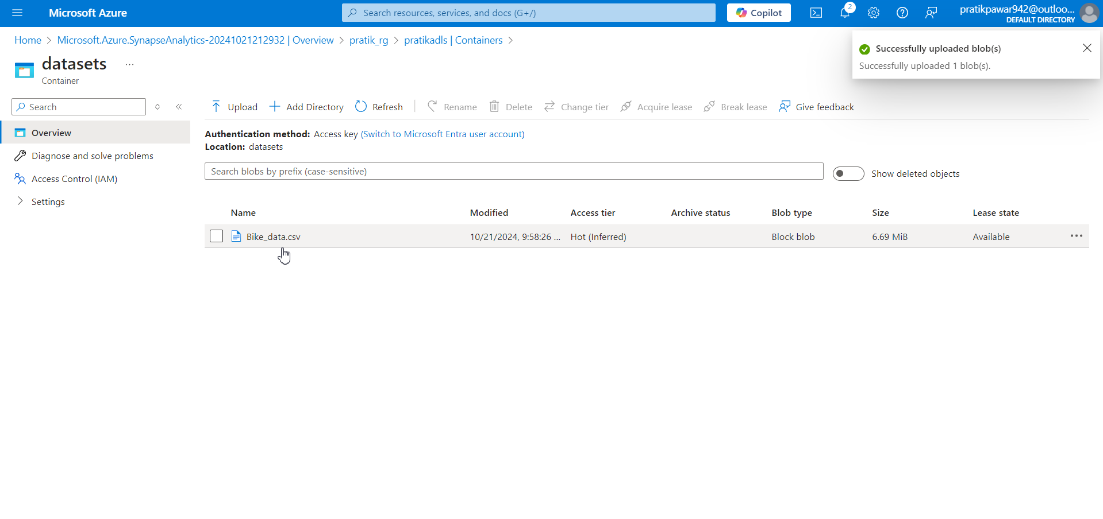
Now upload the required data

Slide 7
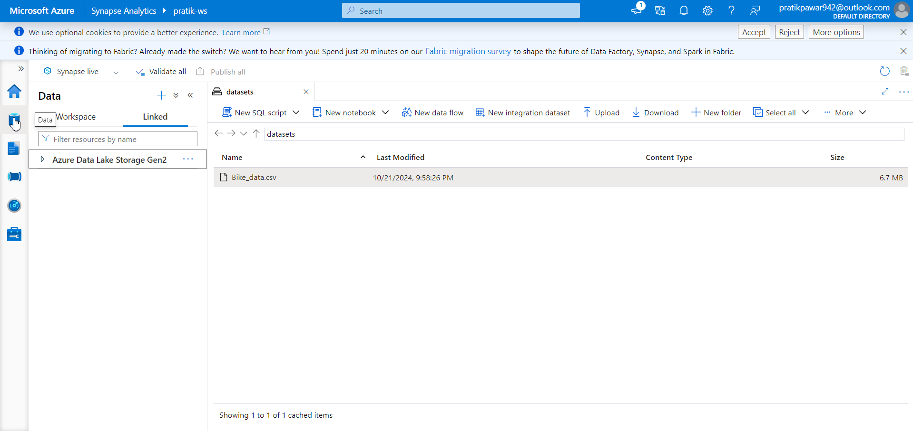
Now go to Data > Linked

Slide 8
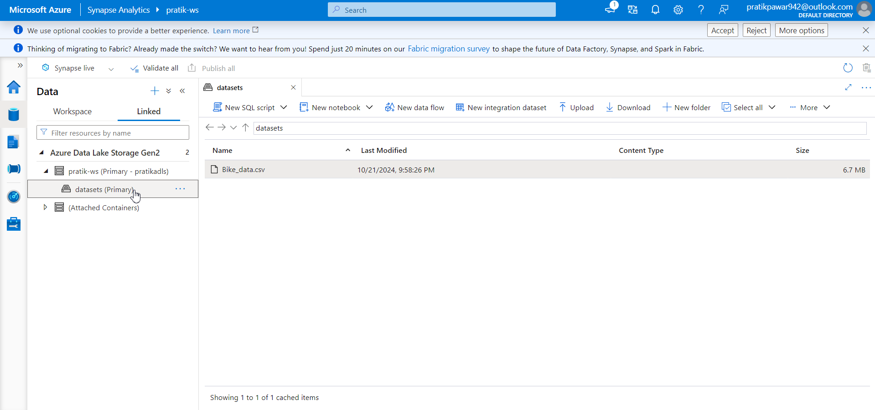
Now click ADLSGen2 > pratikadls > datasets. The ADLS is already linked and the is showen in synapse

Slide 9
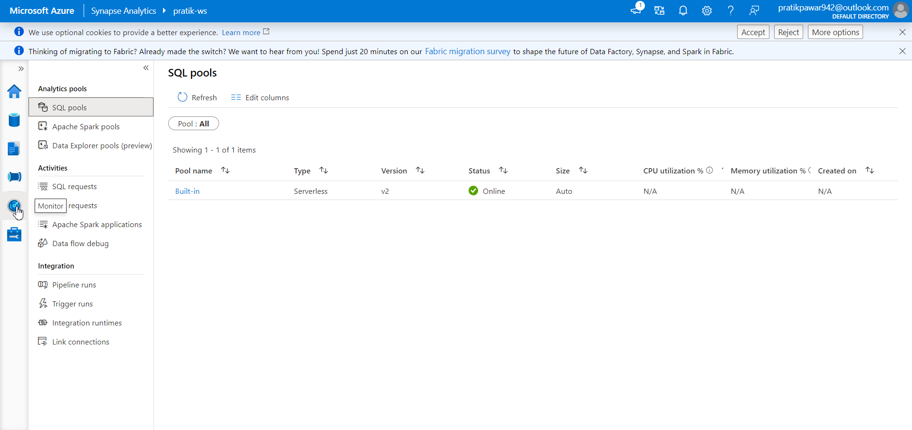
Now go to monitor > SQL pools

Slide 10
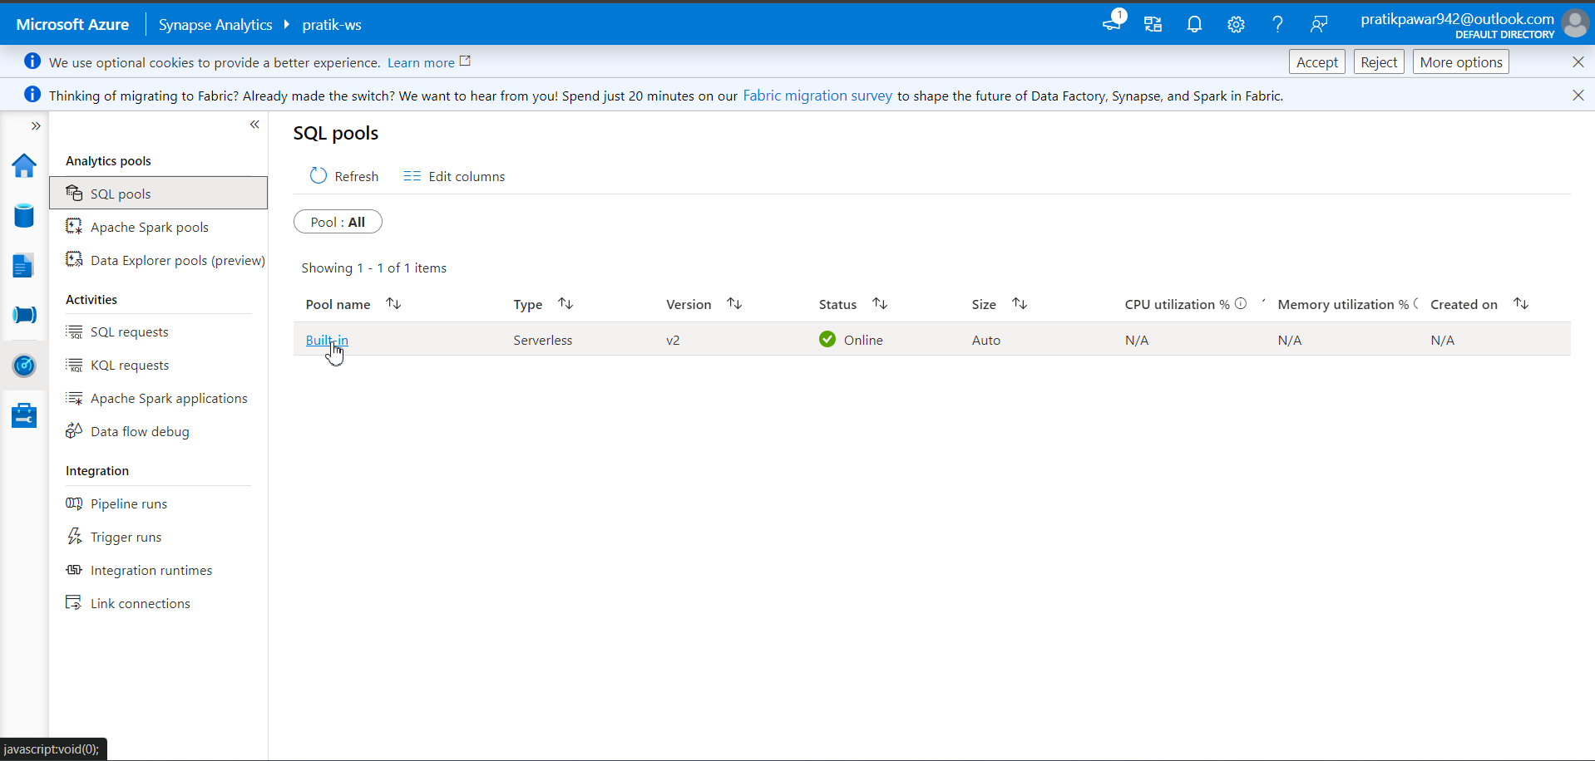
This is already created Built-in Serverless SQL

Slide 11
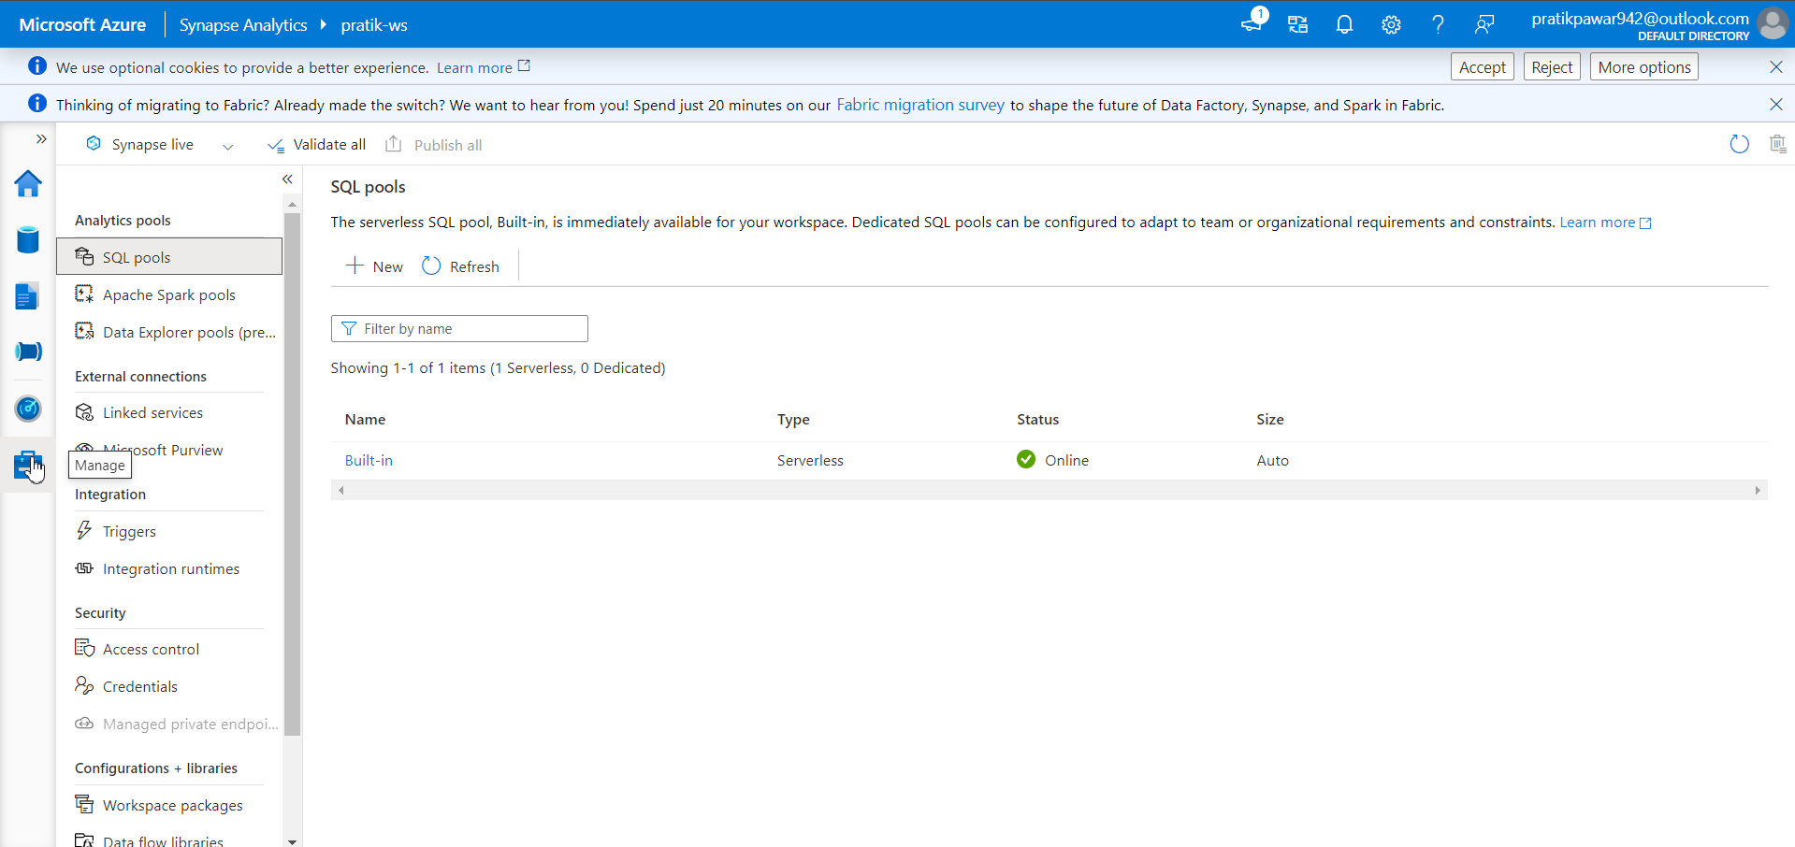
Now go to manage > SQL pools

Slide 12
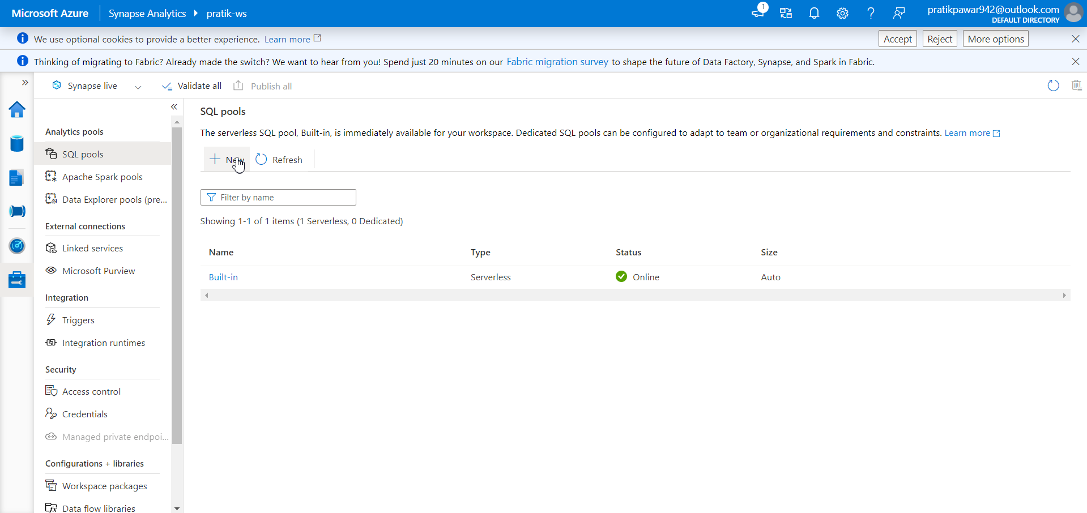
NEW

Slide 13
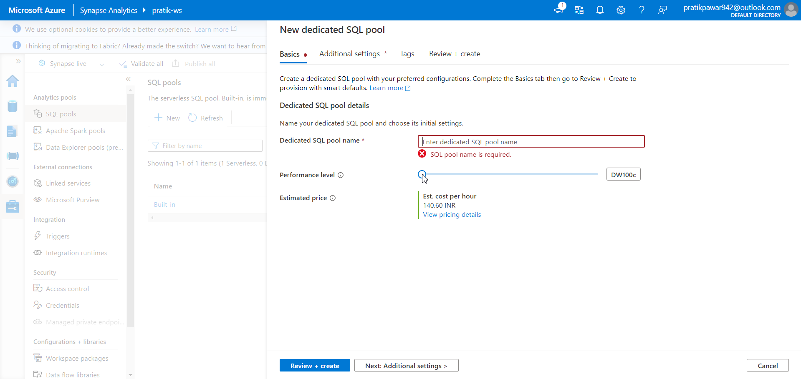
Now here we can create Dedicated SQL pool for storage of Target table. Give name and performance level according to requirement

Slide 14
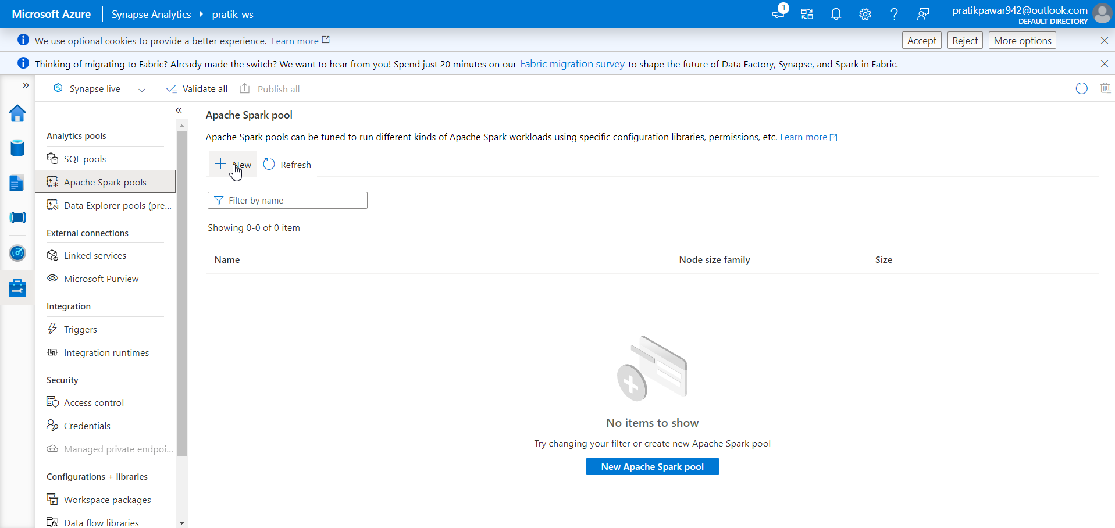
Now go to apache spark pool to create Spark WS (like Databricks)

Slide 15
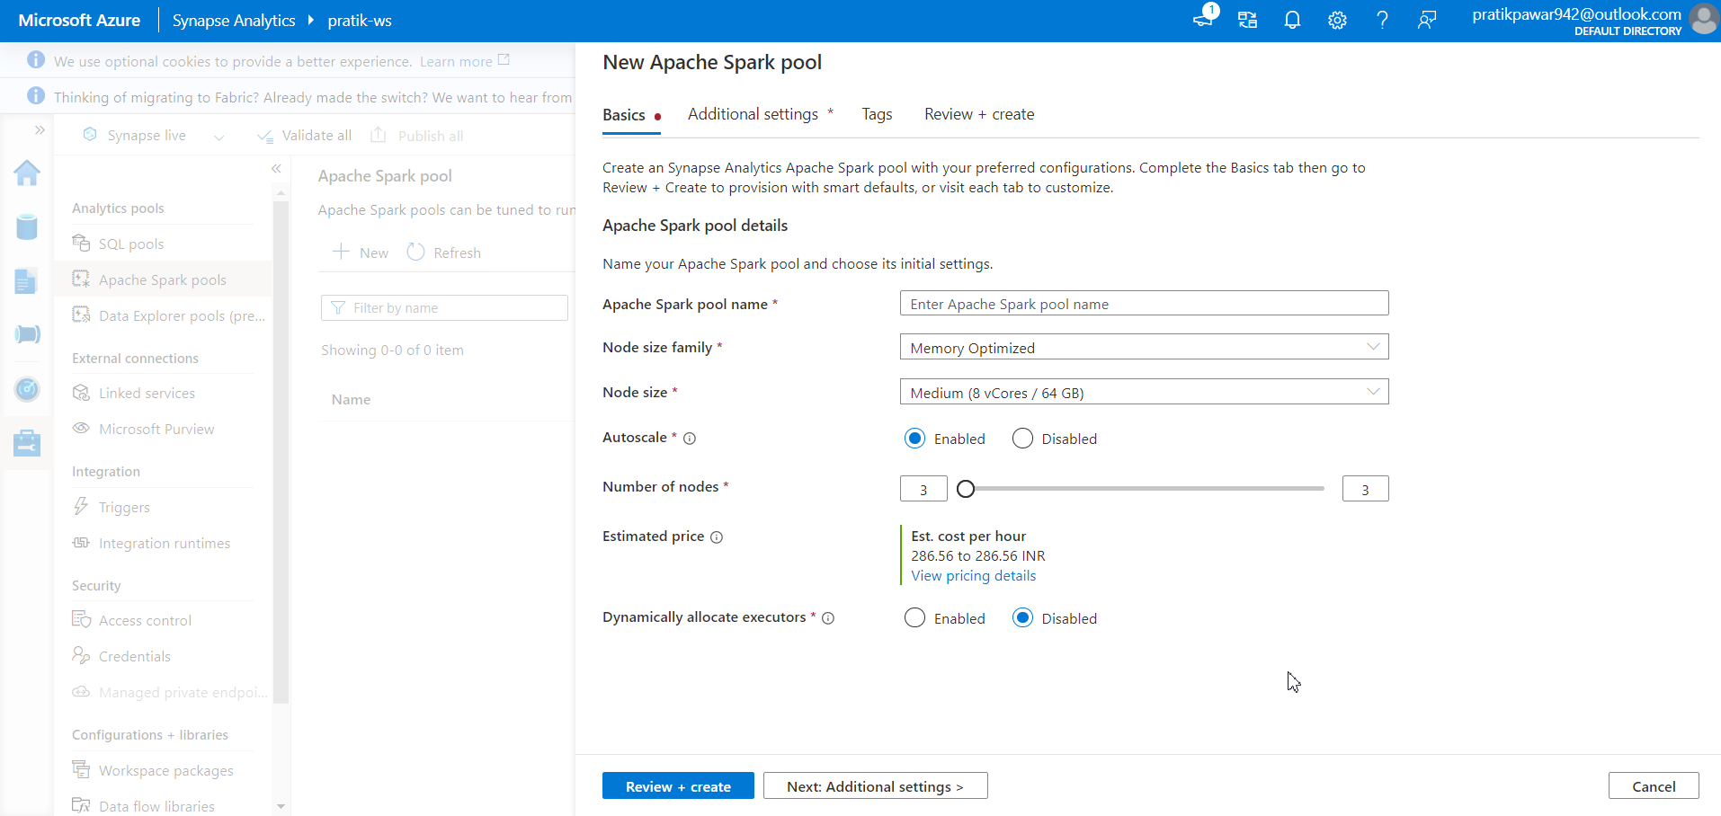
Now select this according to requirement

Slide 16
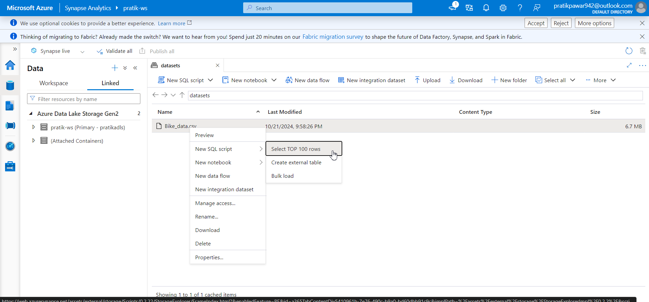
Now go to data > bikedata.csv > New SQL script (Right Click) > Select Top 1000

Slide 17
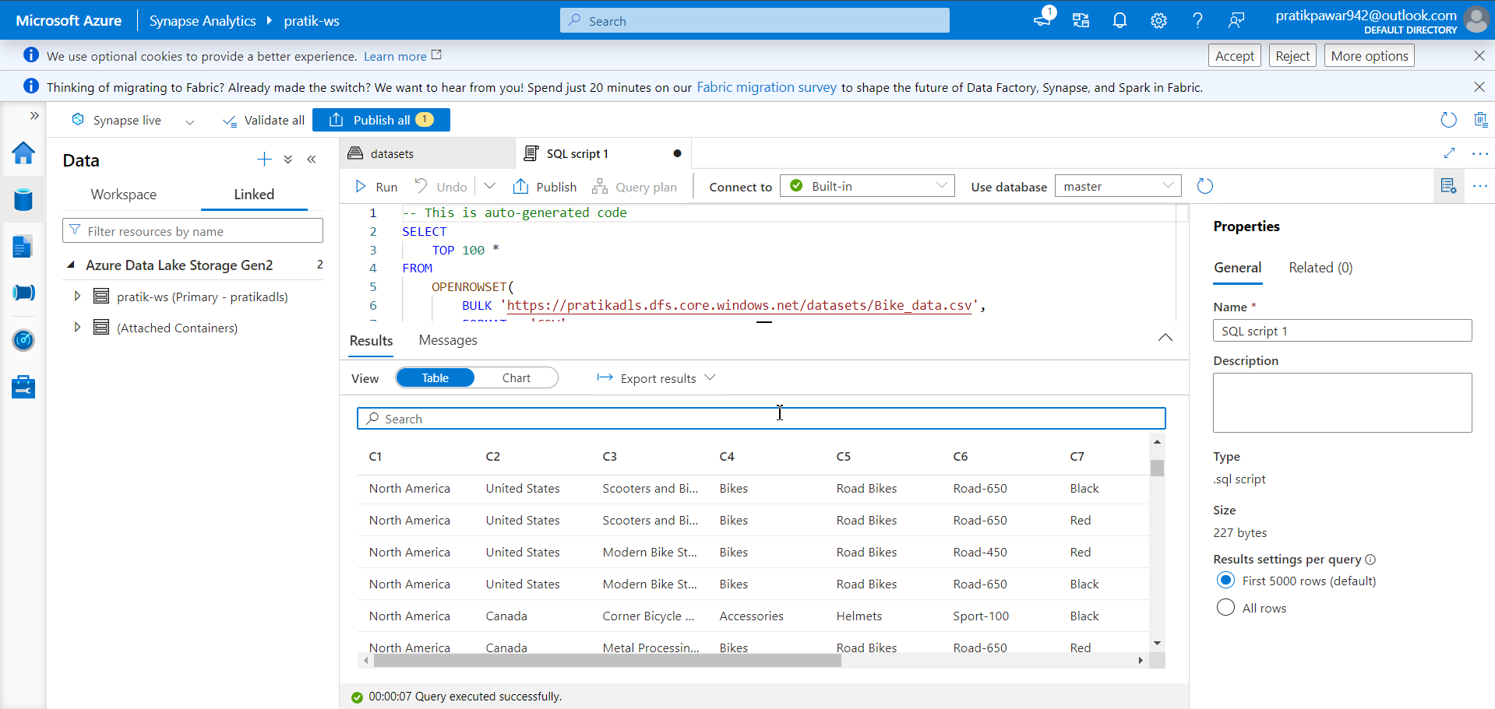
Now here we can see the data through SQL

Slide 18
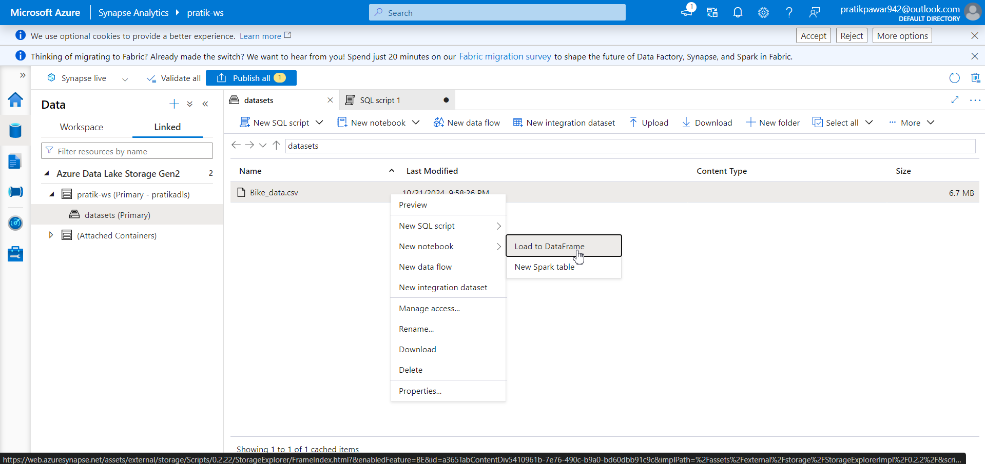
Now if go to ‘Load to Dataframe’ it will open in Spark Pool and it will give IDE like Databricks. There in Spark pool we can work similar like databricks

Slide 19
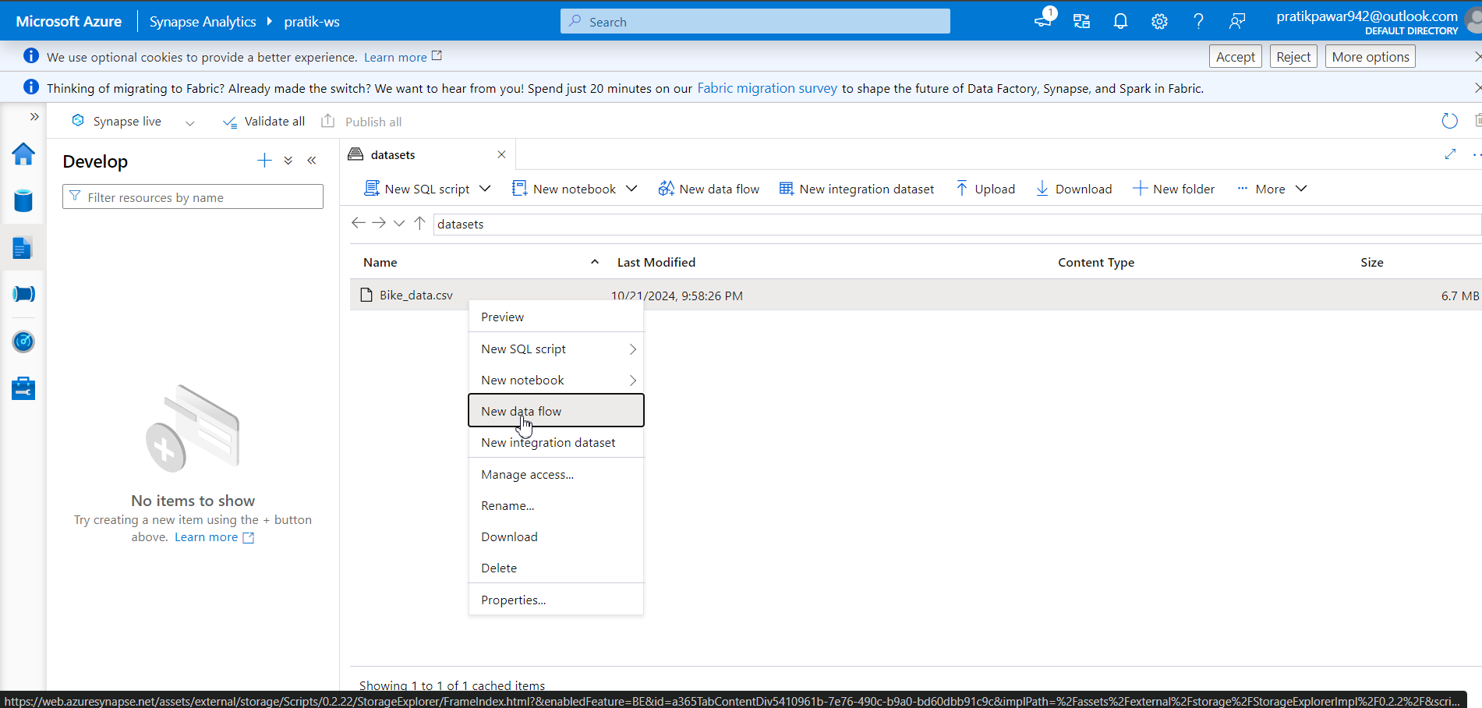
Now go to New data Flow

Slide 20
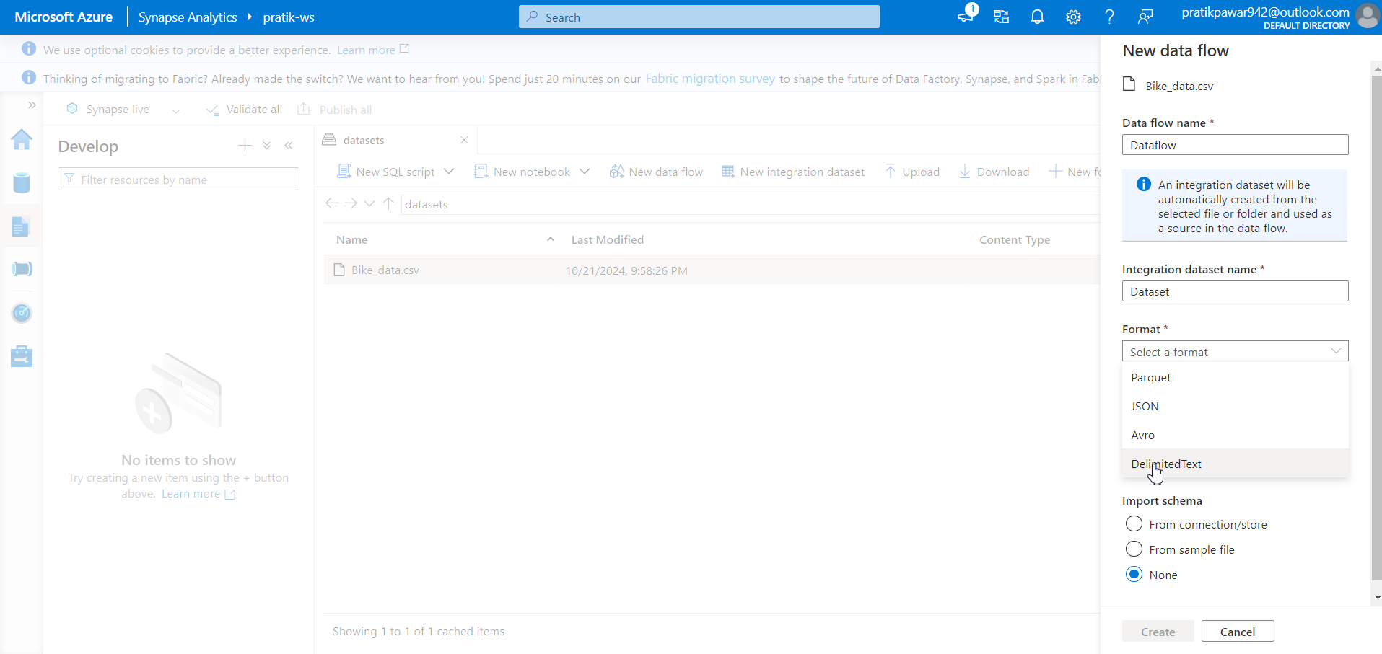
Select file Format – CSV so delimited text

Slide 21
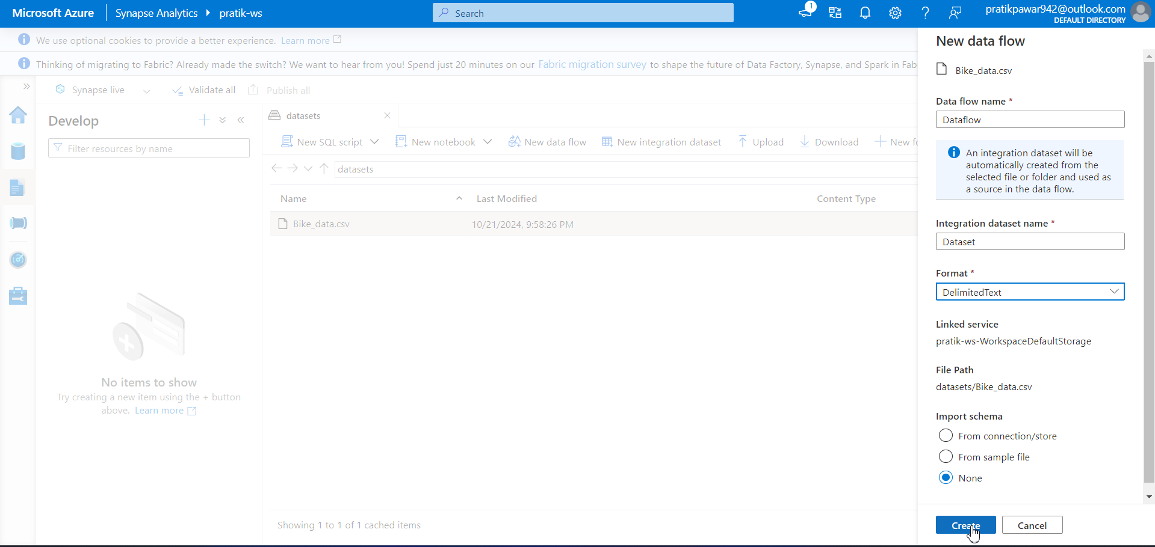
Create

Slide 22
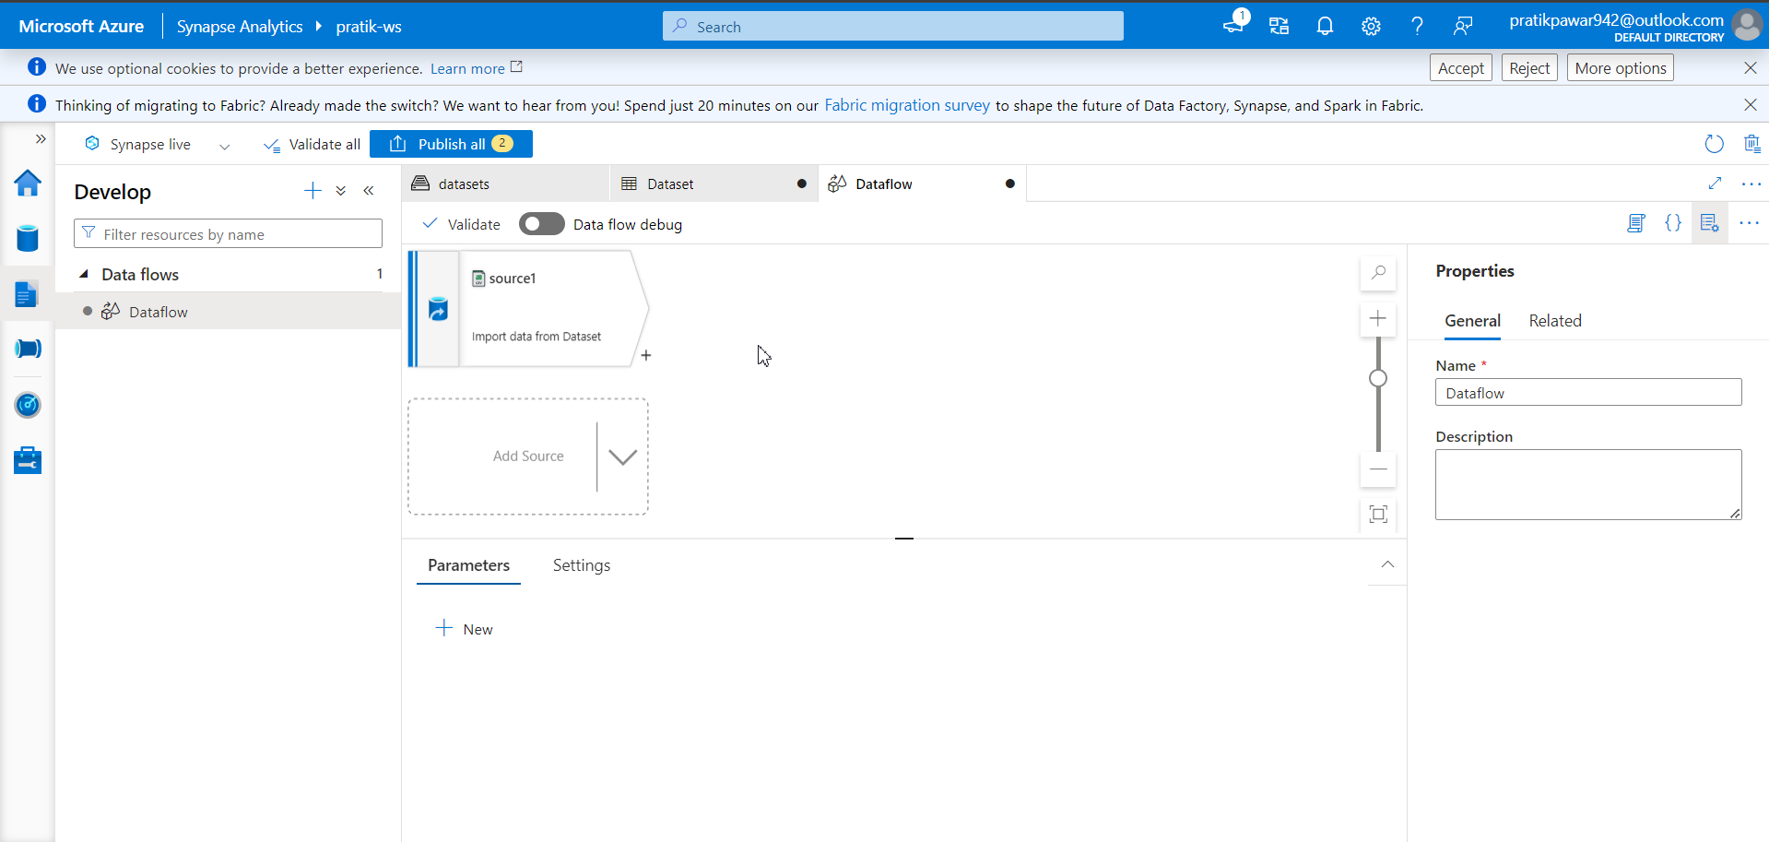
Now we can perform dataflow like ADF here

Slide 23

On Data Flow debug

Slide 24
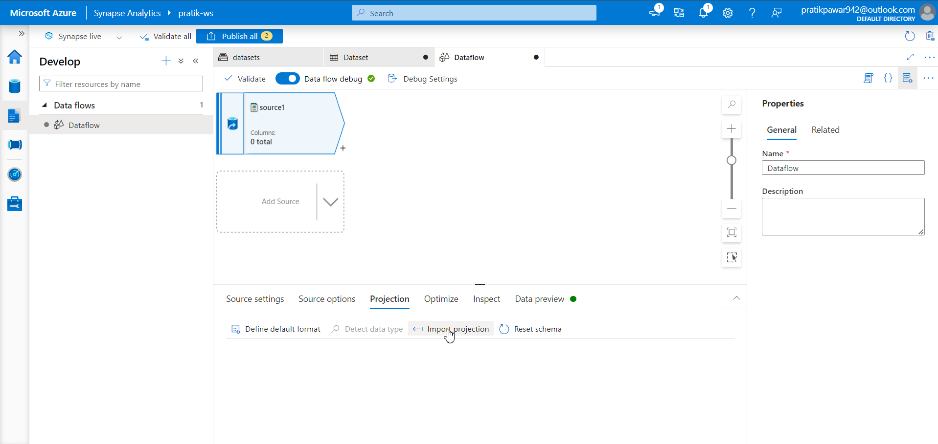
Go to projection > import projection to see columns

Slide 25
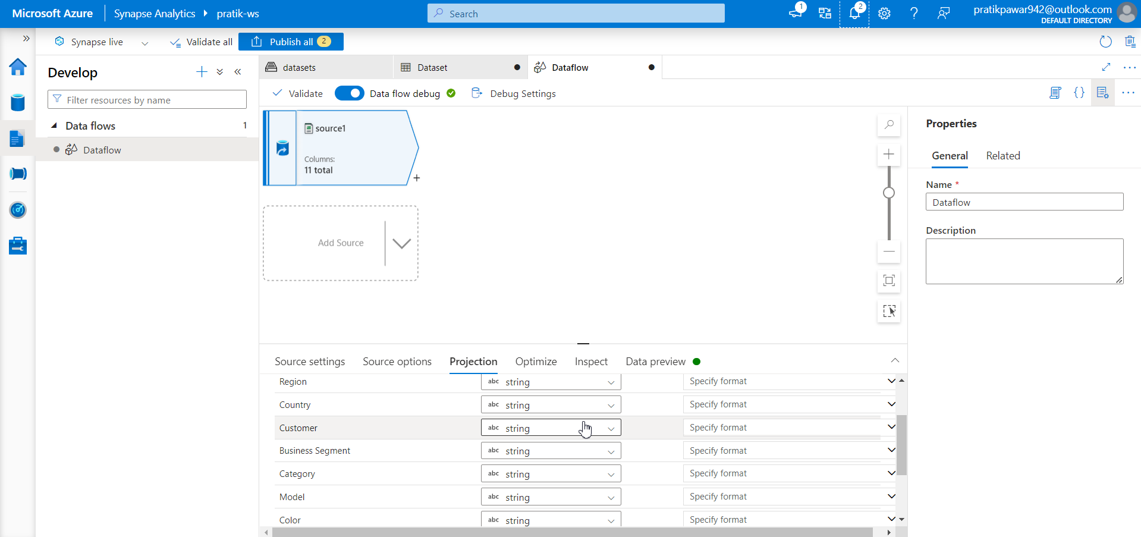
Projection successfully imported

Slide 26
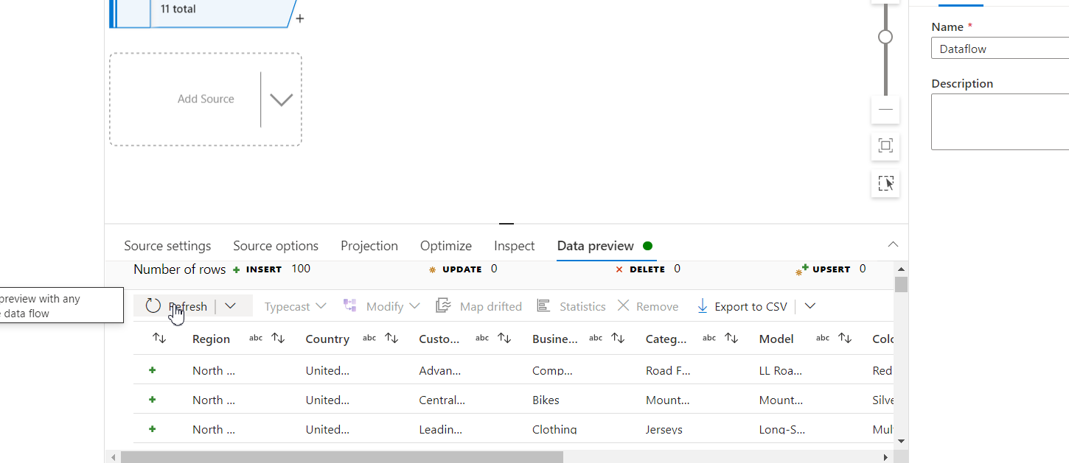
Go to data preview > refresh to preview data

Slide 27
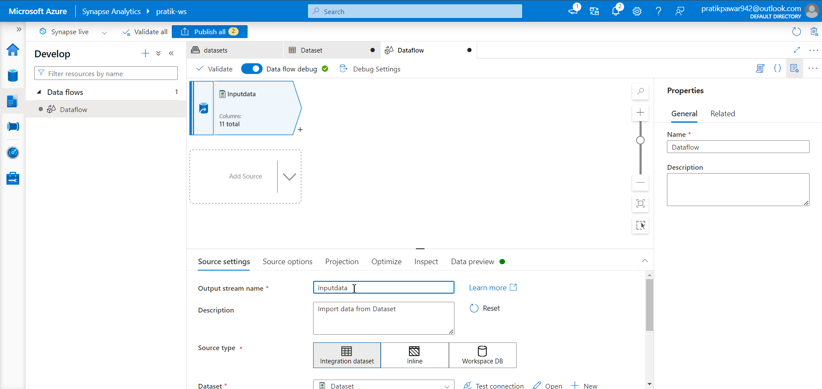
Rename as ‘InputData’

Slide 28
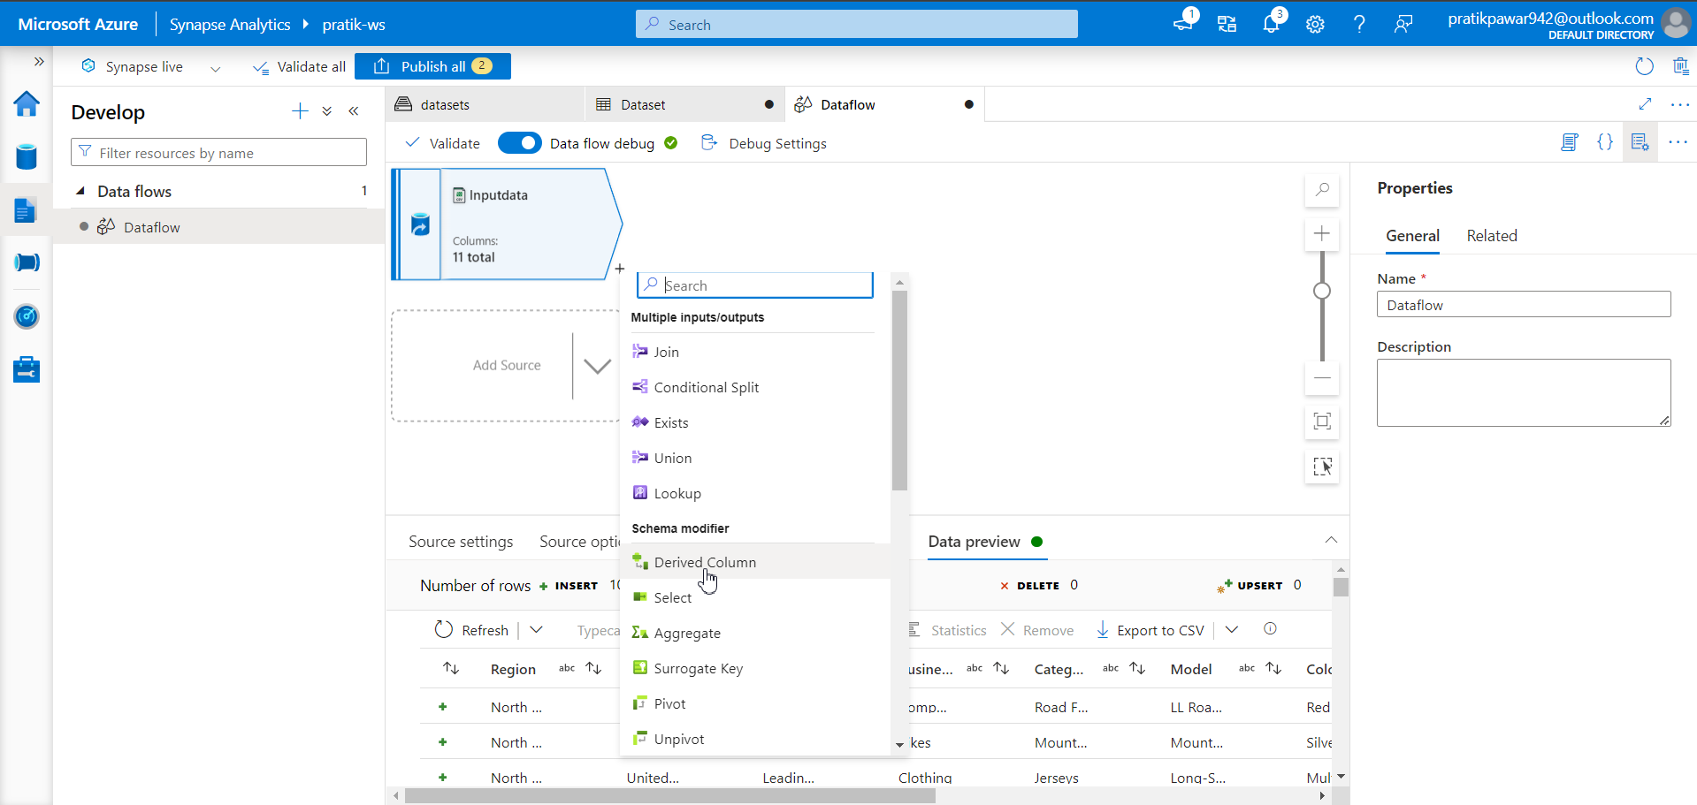
Derived Column

Slide 29
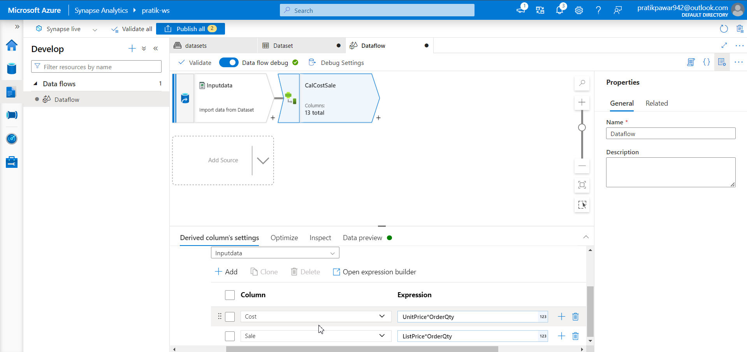
Perform the Required Transformation

Slide 30
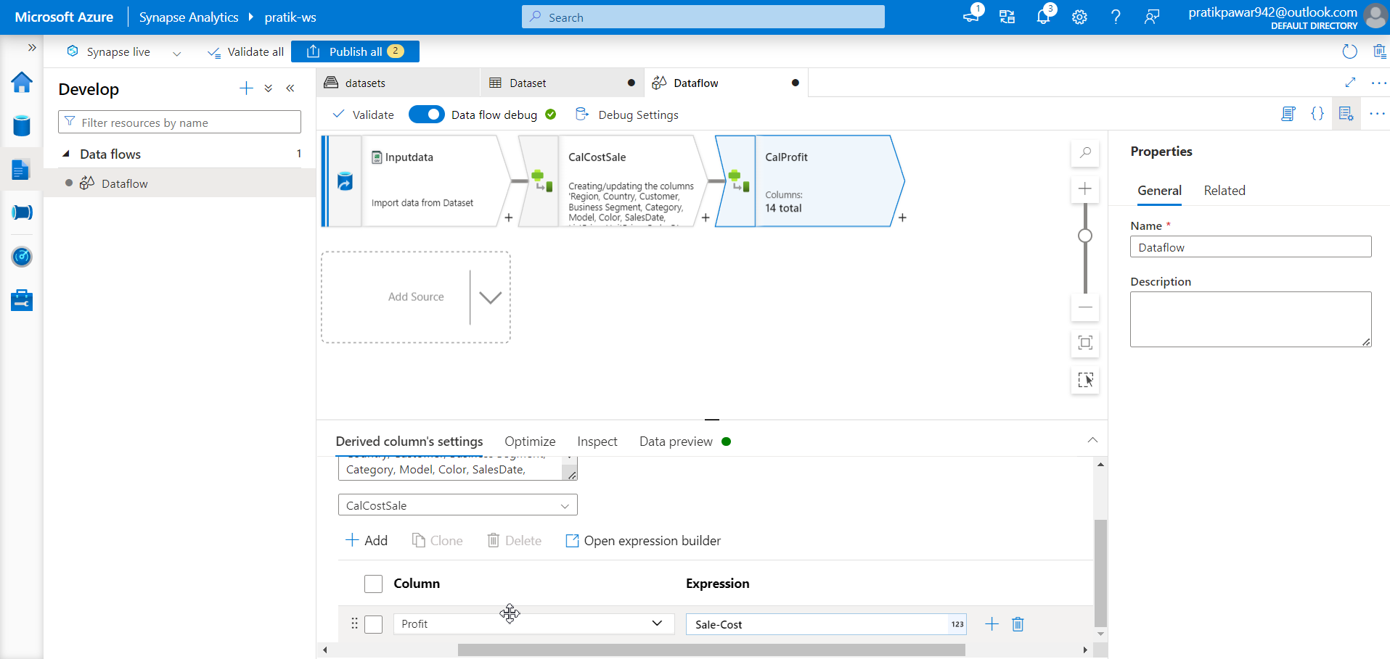
Calculated Profit

Slide 31
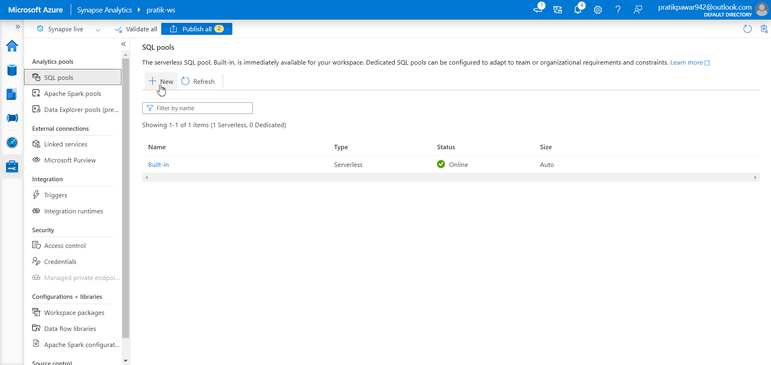
Now go to manage > SQL pool > New to Create Dedicated SQL Pool for Sink of Target Table

Slide 32
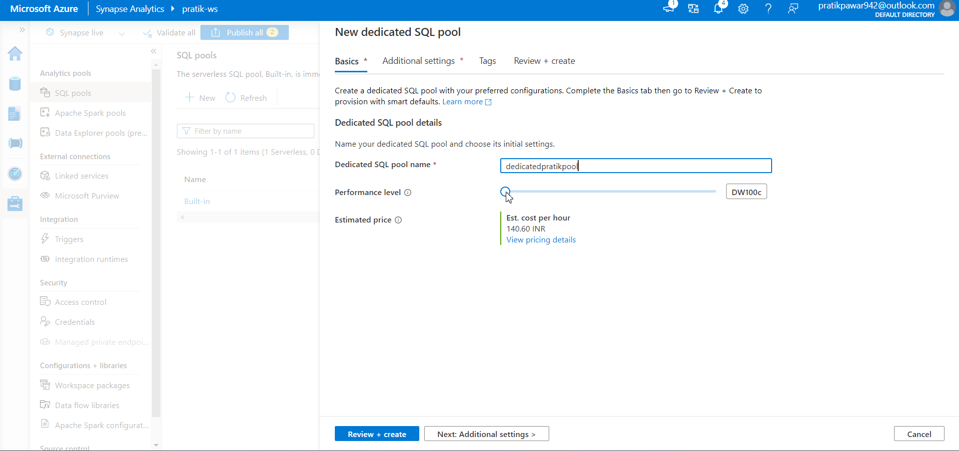
Give SQL pool name and performance level

Slide 33
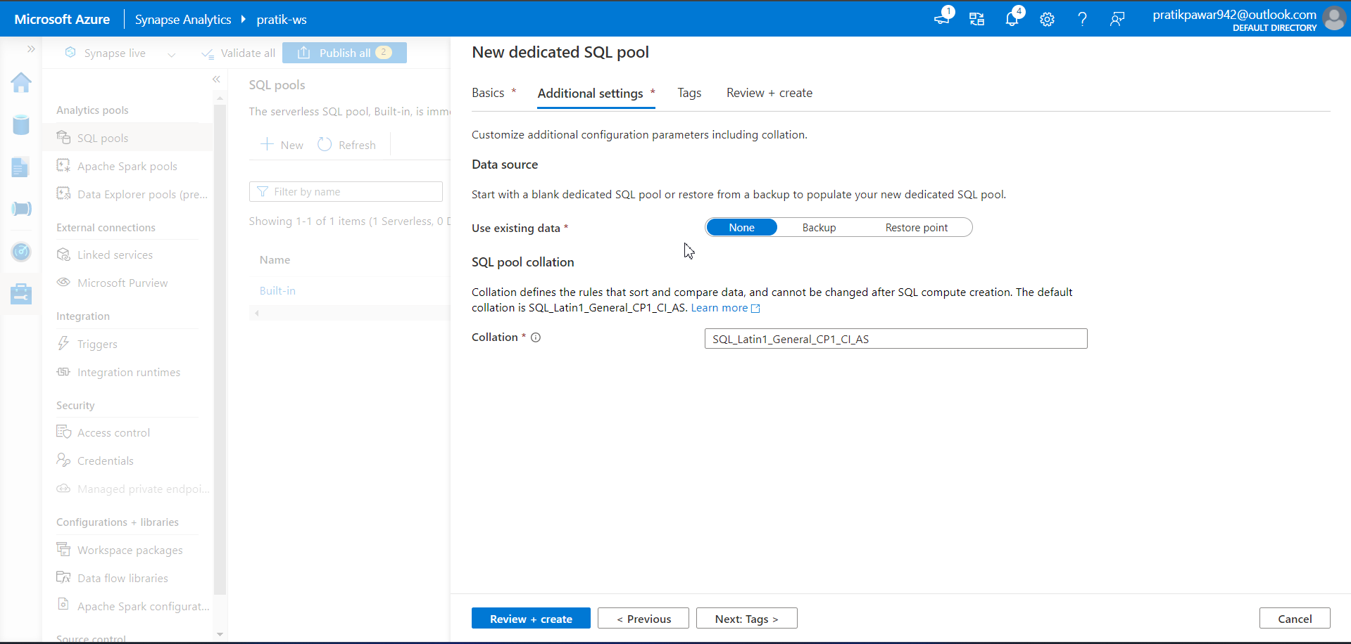
Additional settings

Slide 34
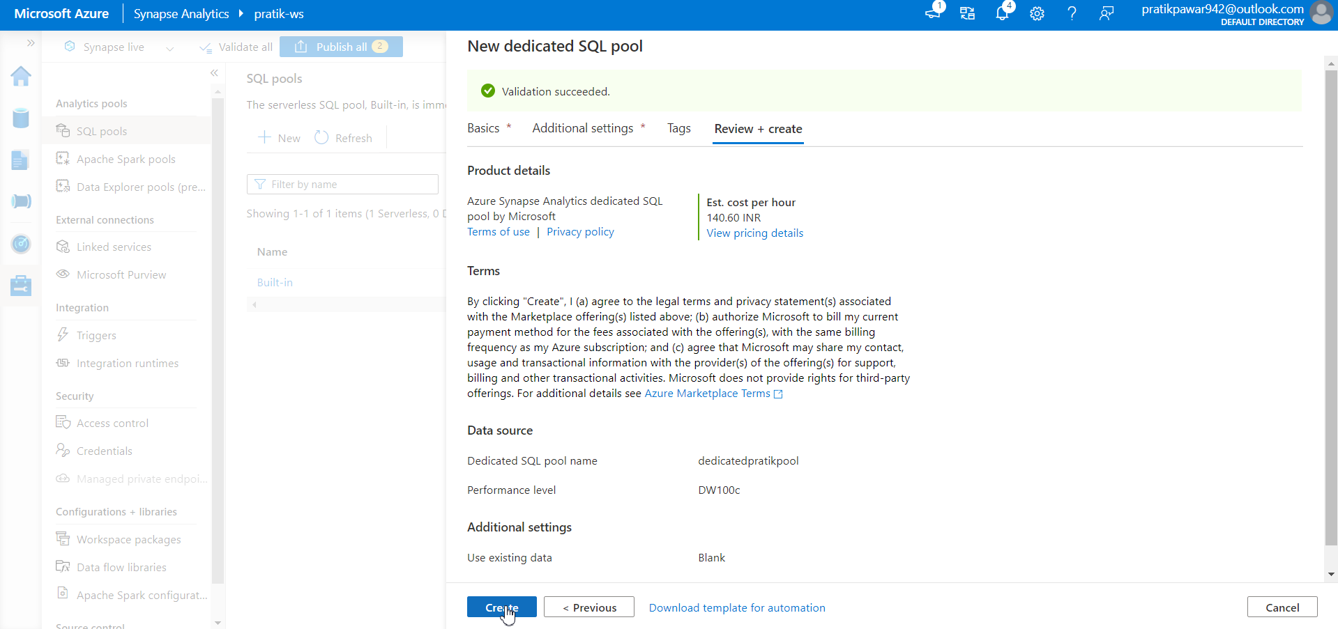
Create

Slide 35
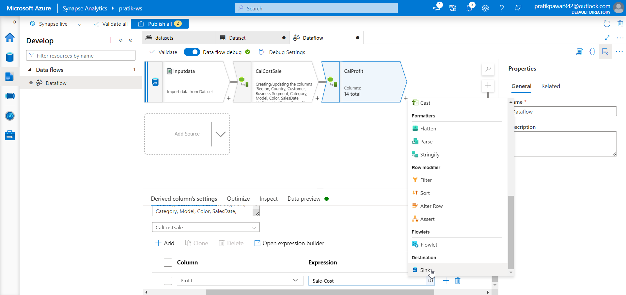
Now create Sink

Slide 36
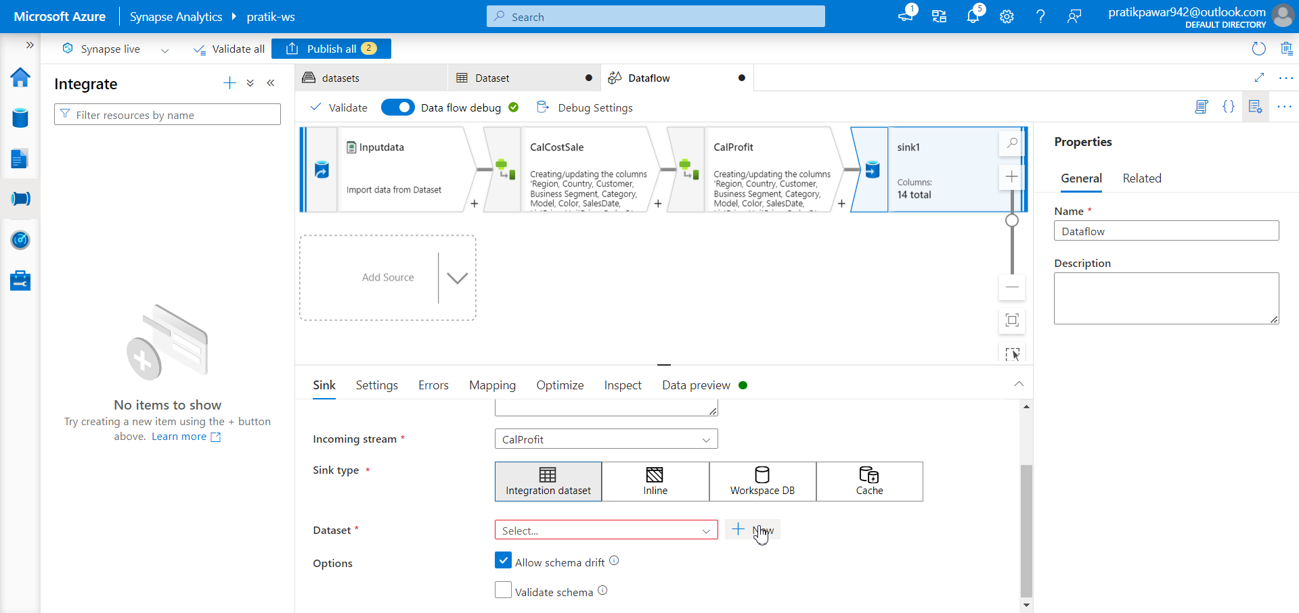
New

Slide 37
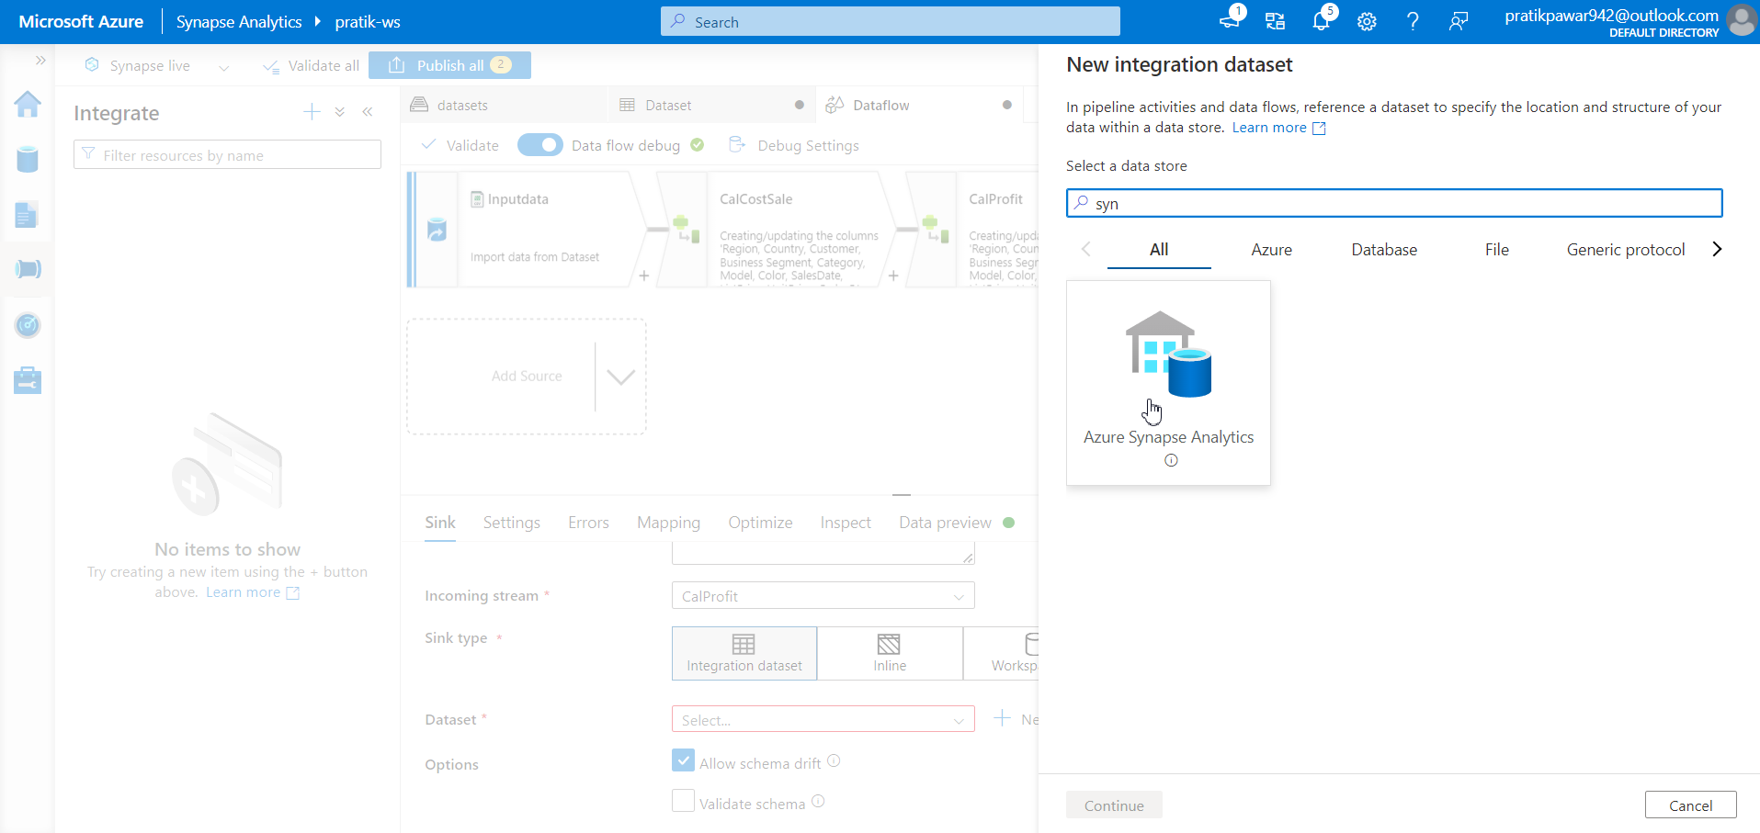
Azure Synapse Analytics

Slide 38
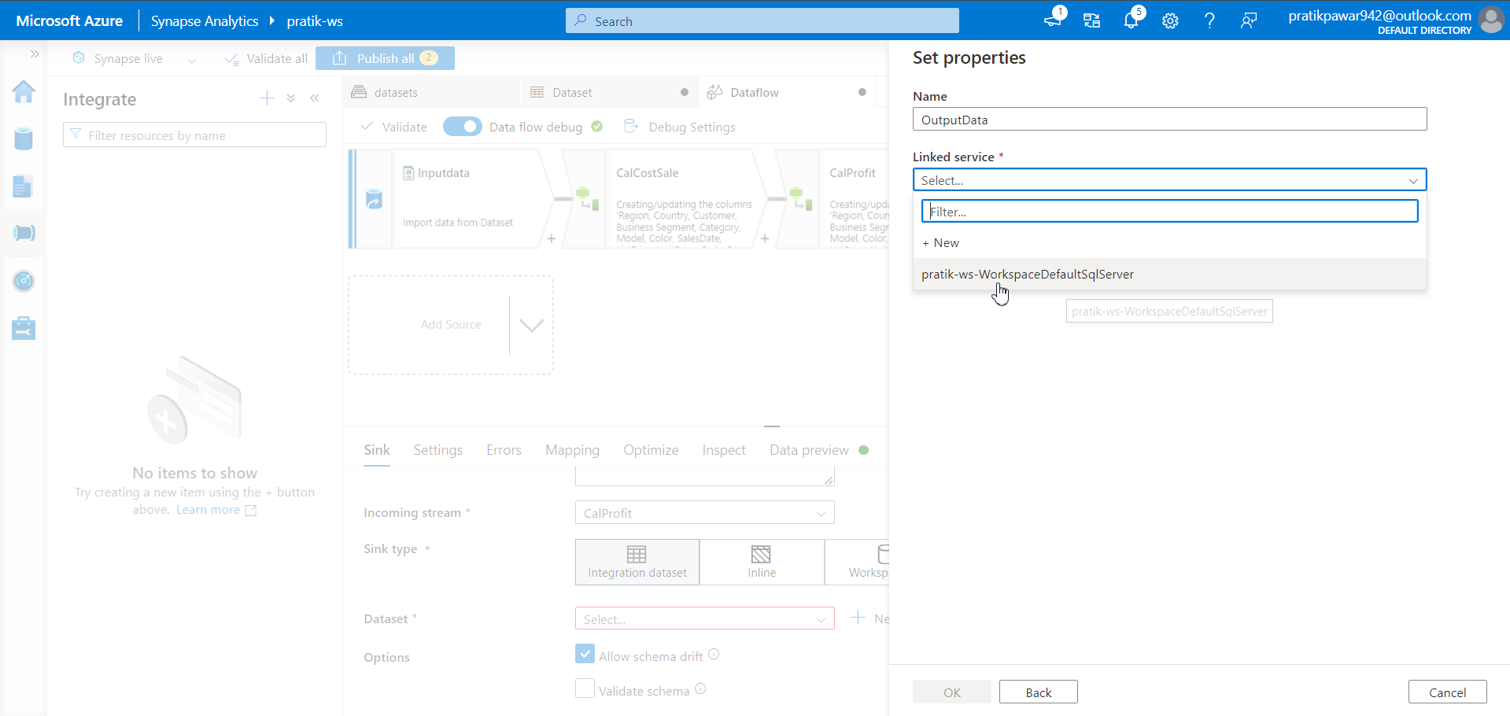
Now clicked the linked service as it has already connected via Synapse

Slide 39
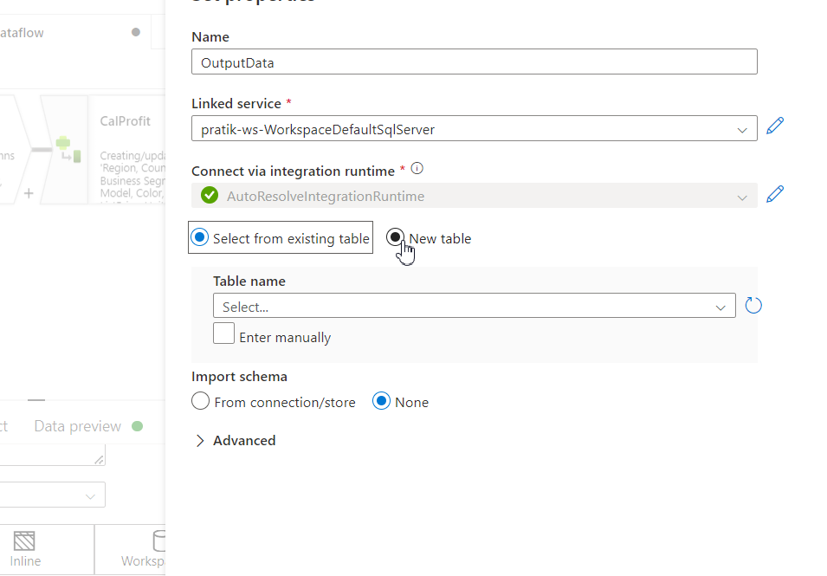
New Table

Slide 40
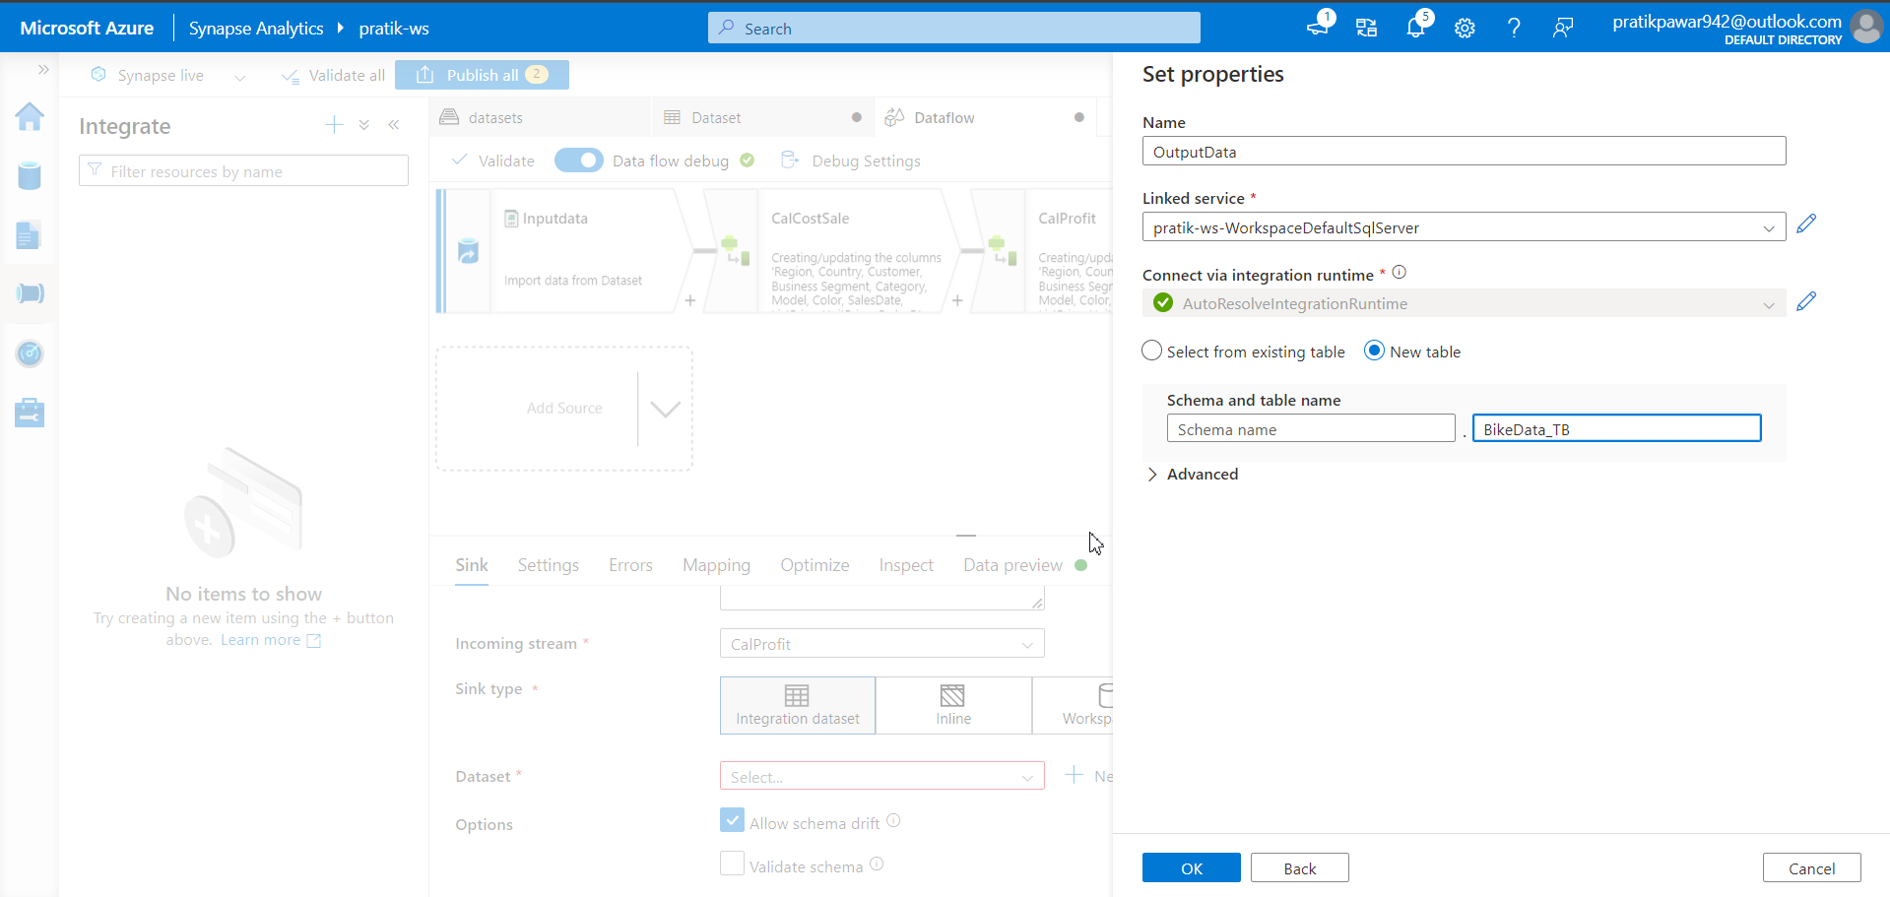
Rename as ‘BikeData_TB’ > Create

Slide 41
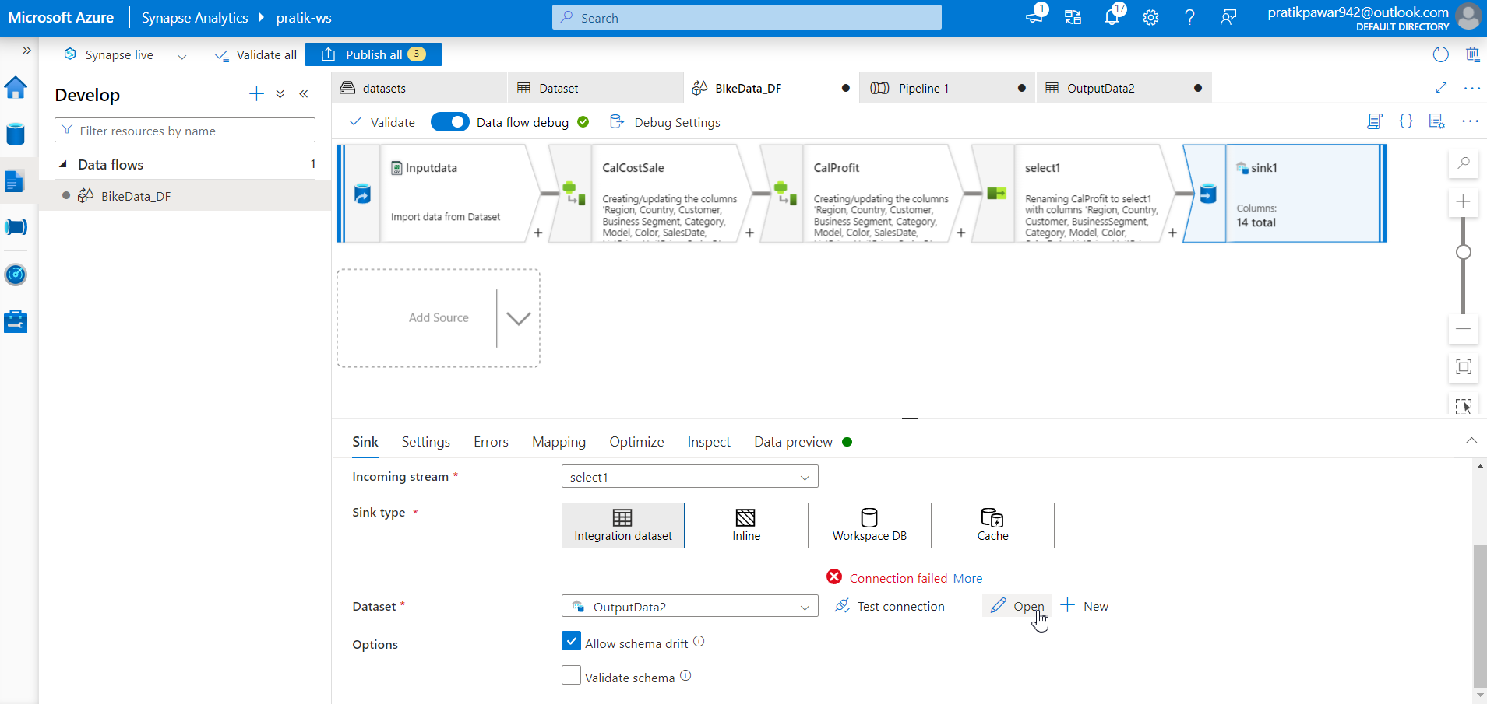
Also Go to Sink > Open

Slide 42
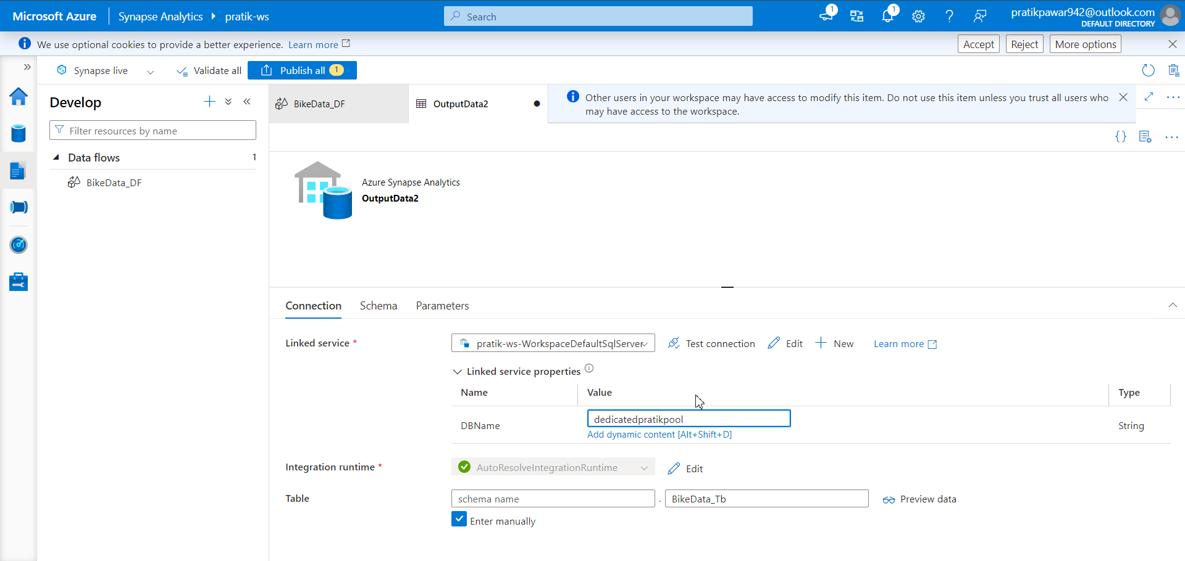
Give DBname (Important)

Slide 43
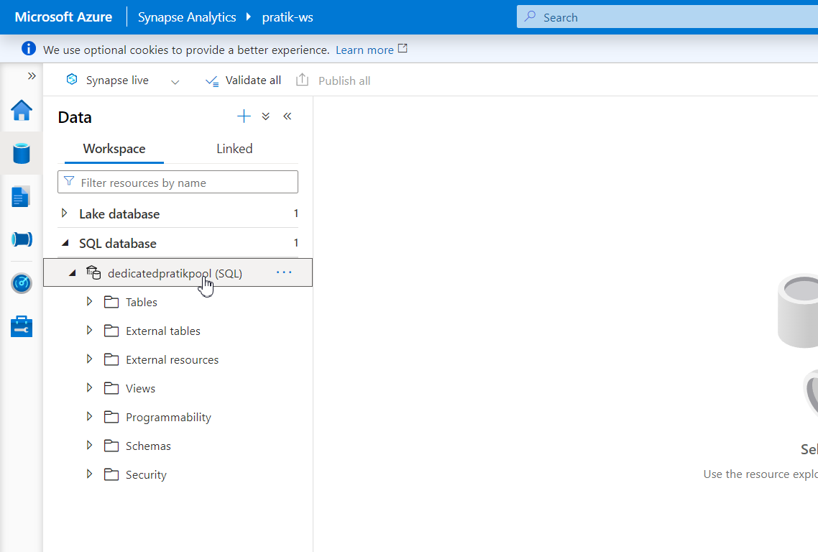
Now Give this name to DBName

Slide 44
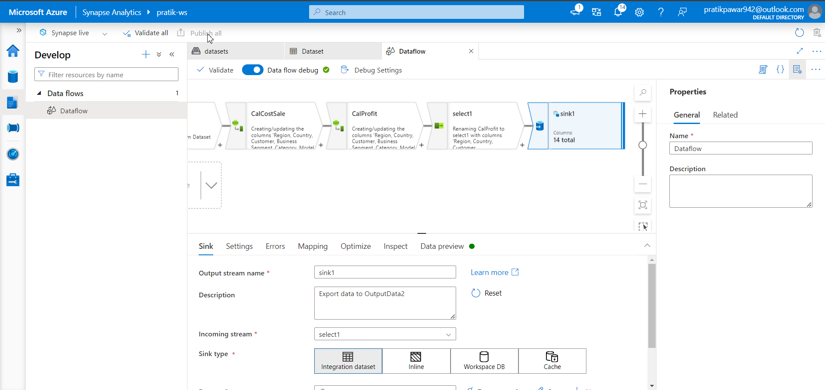
Publish

Slide 45
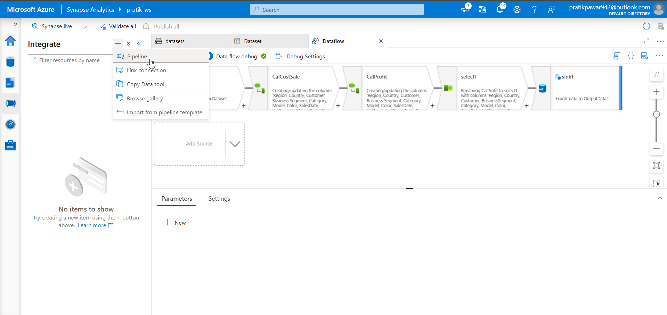
Pipeline

Slide 46
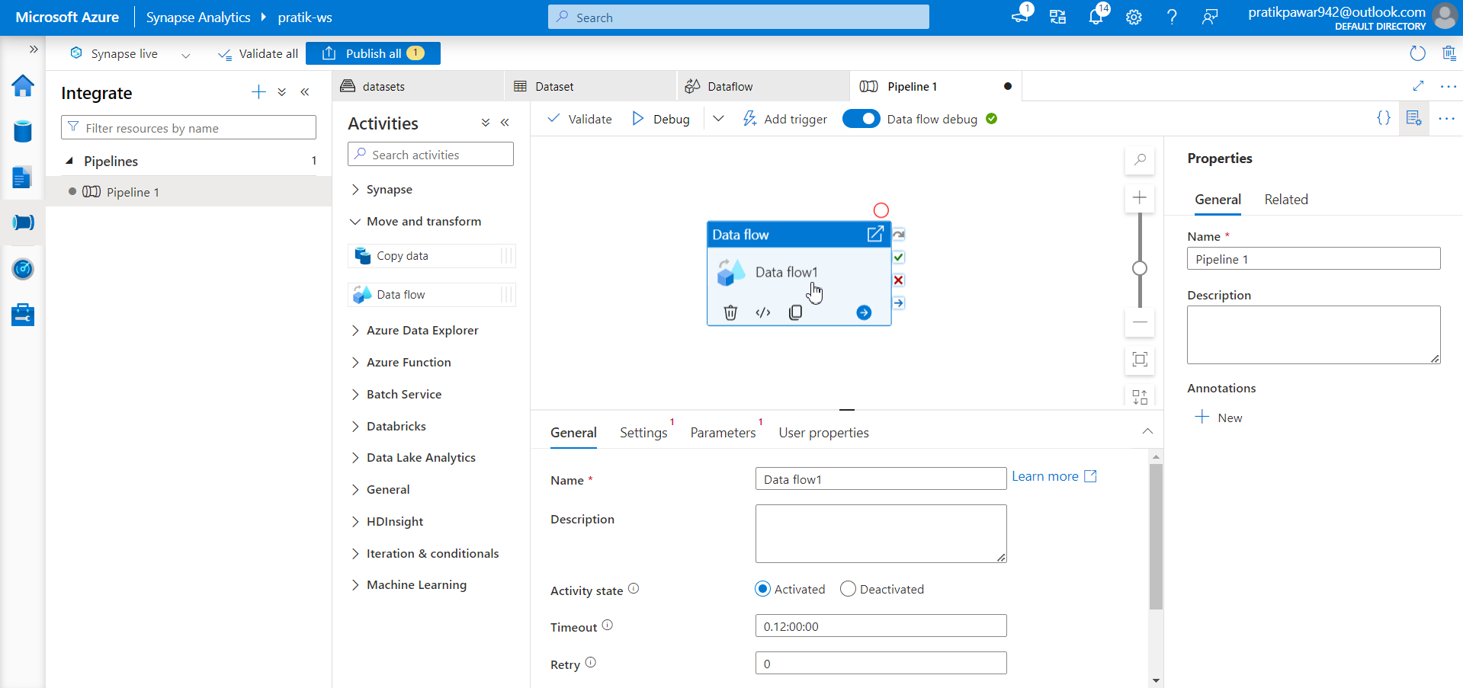
Dataflow

Slide 47
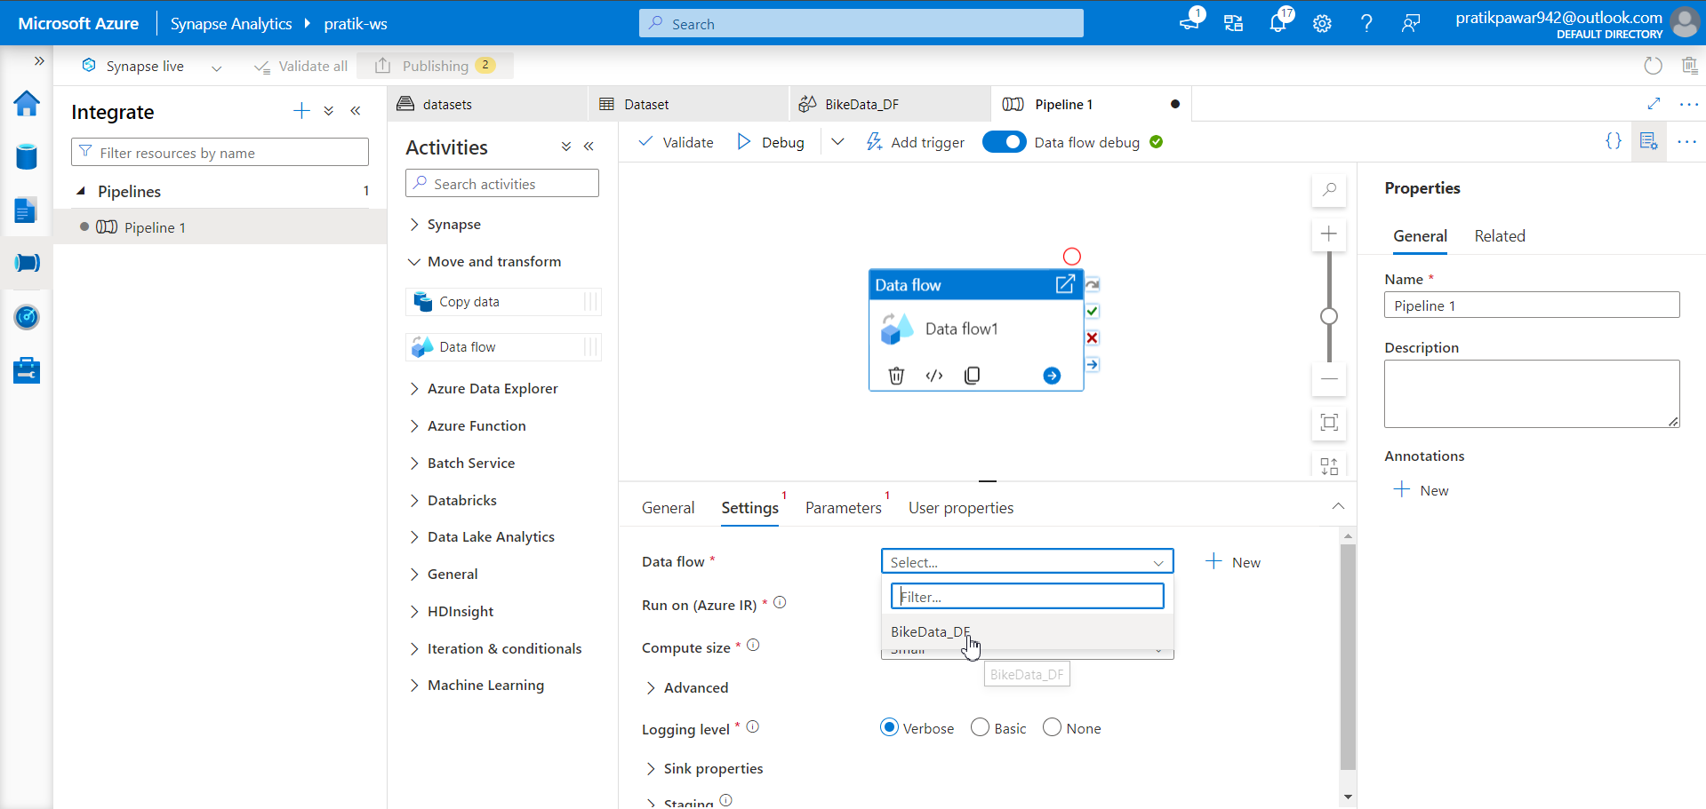
Select BikeData_DF

Slide 48
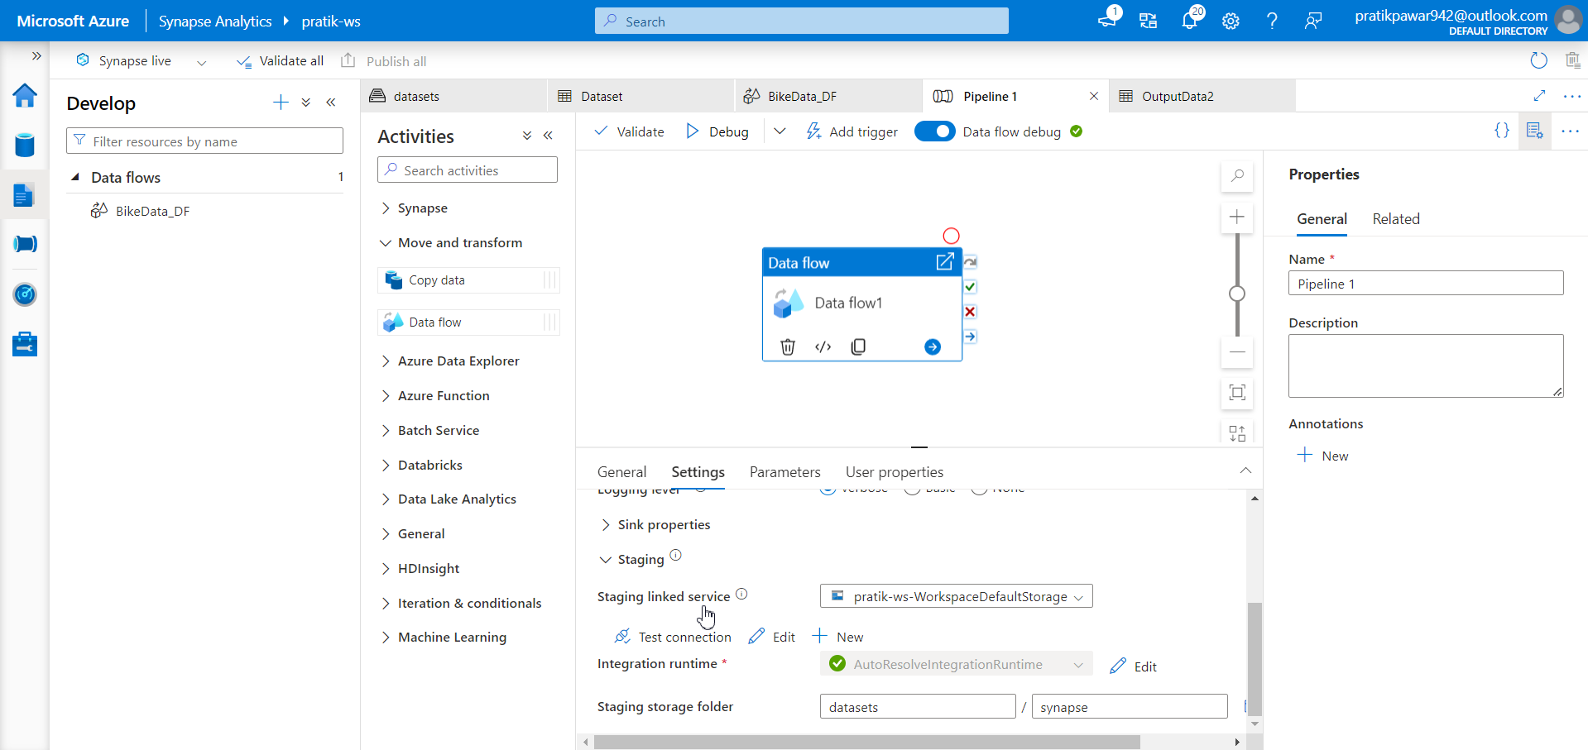
Also we have add staging linked service and its folder (mandatory)

Slide 49
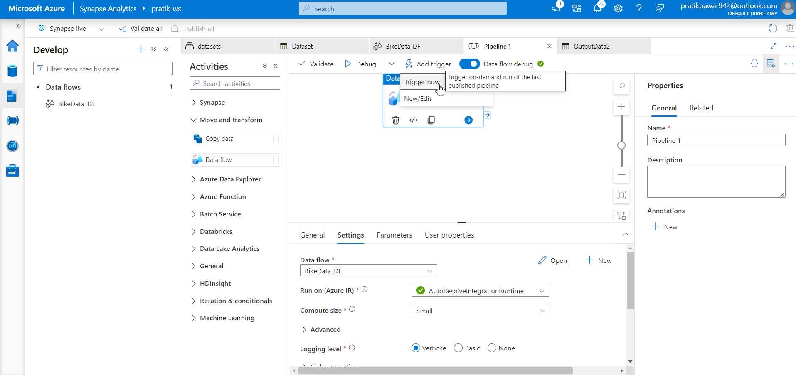
Trigger Now

Slide 50
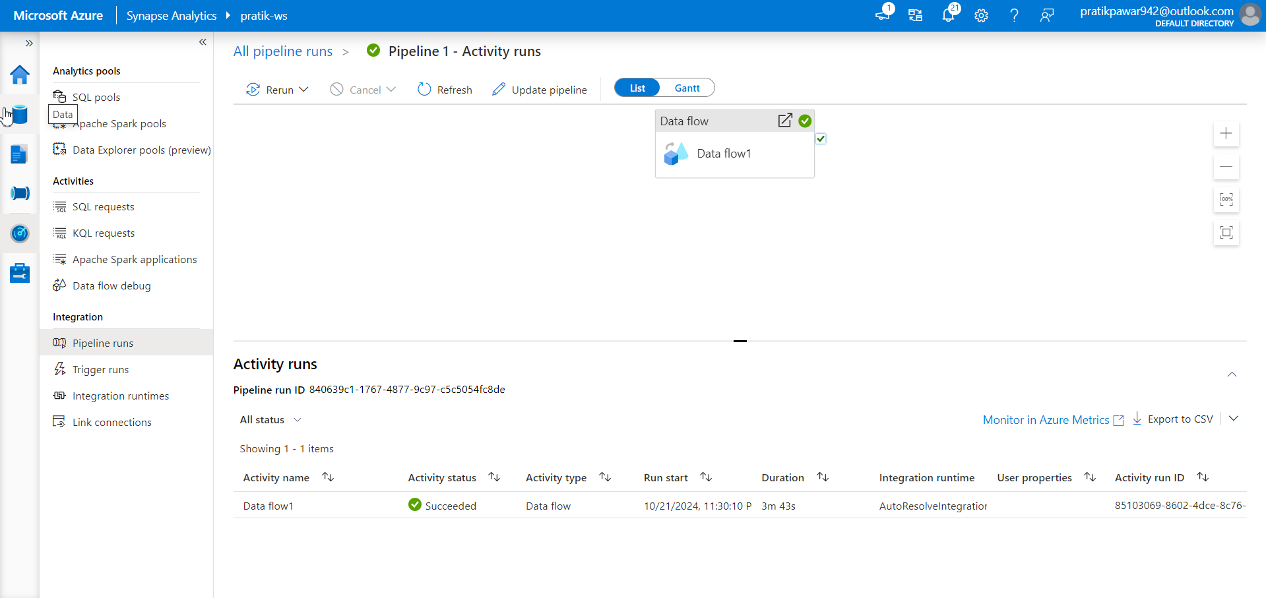
Success

Slide 51
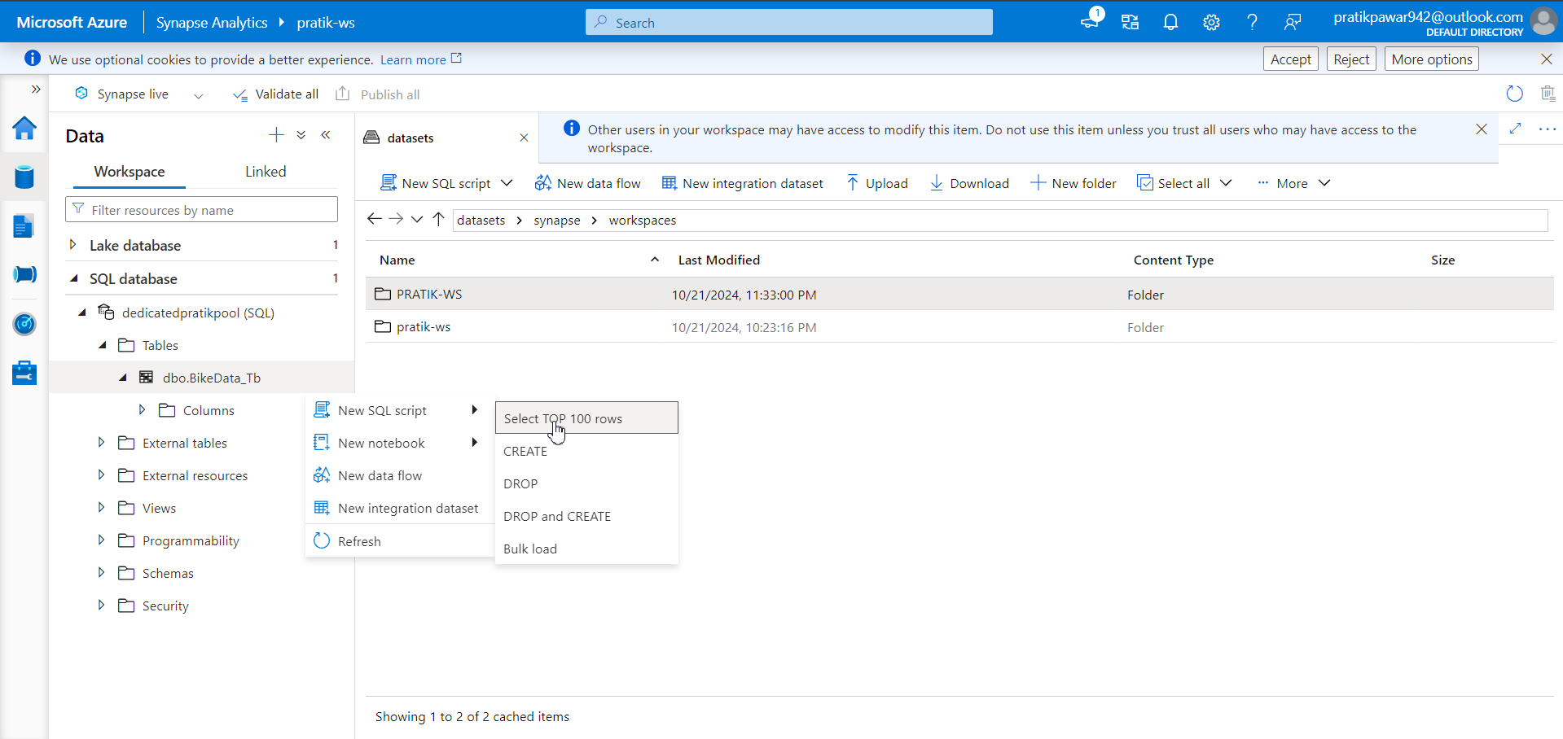
Now if we go to WorkSpace > SQL database > Dedicatedpratikpool > Table > bikeData_TB > Select 100 rows

Slide 52
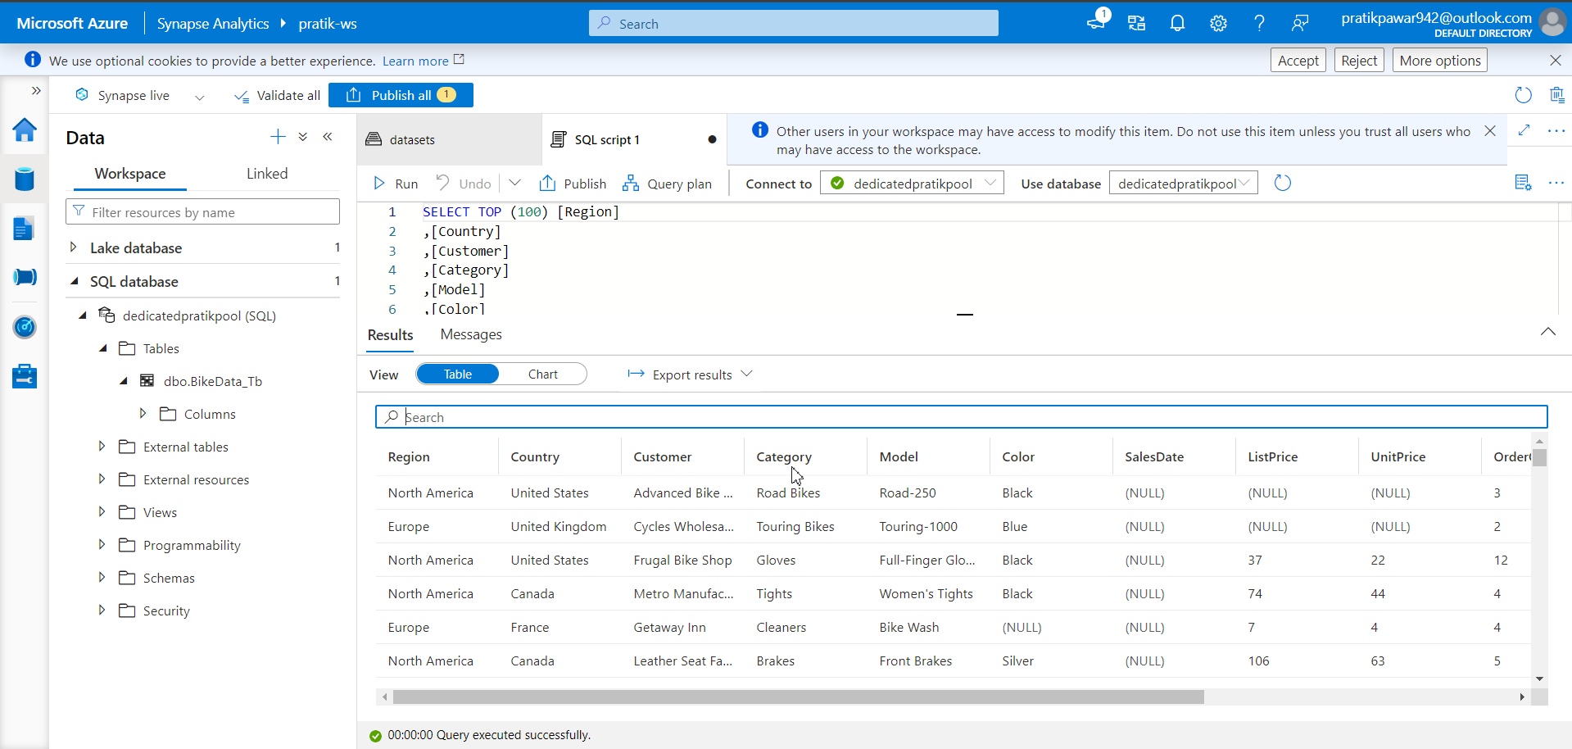
We can see the data in Dedicated SQL Database

Slide 53
Similar you can do data transformation in Apache Spark pool in same way

